Slide 1
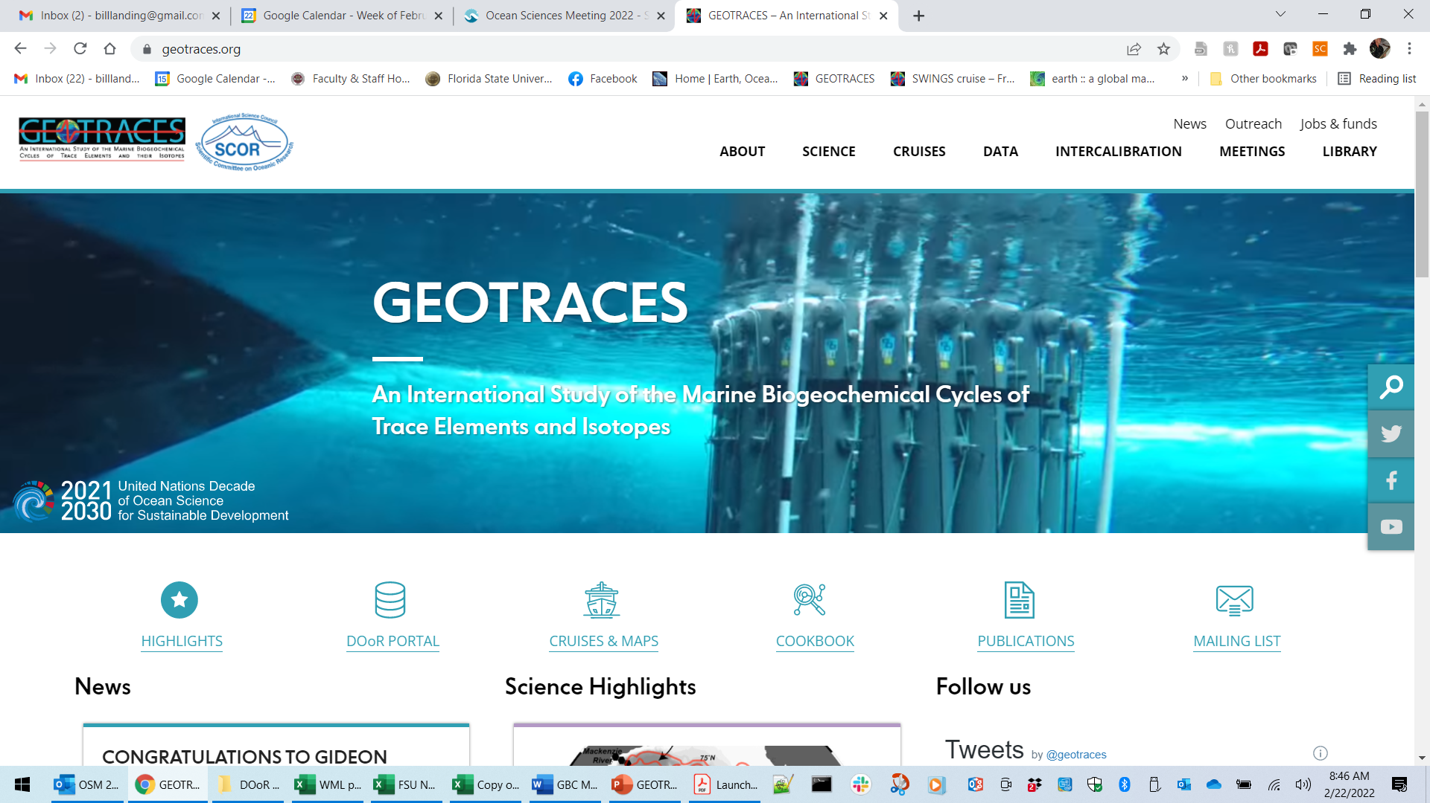
How can researchers register data for the next GEOTRACES Intermediate Data Product (IDP)?
Go to the GEOTRACES IPO web site: https://GEOTRACES.org

Slide 2
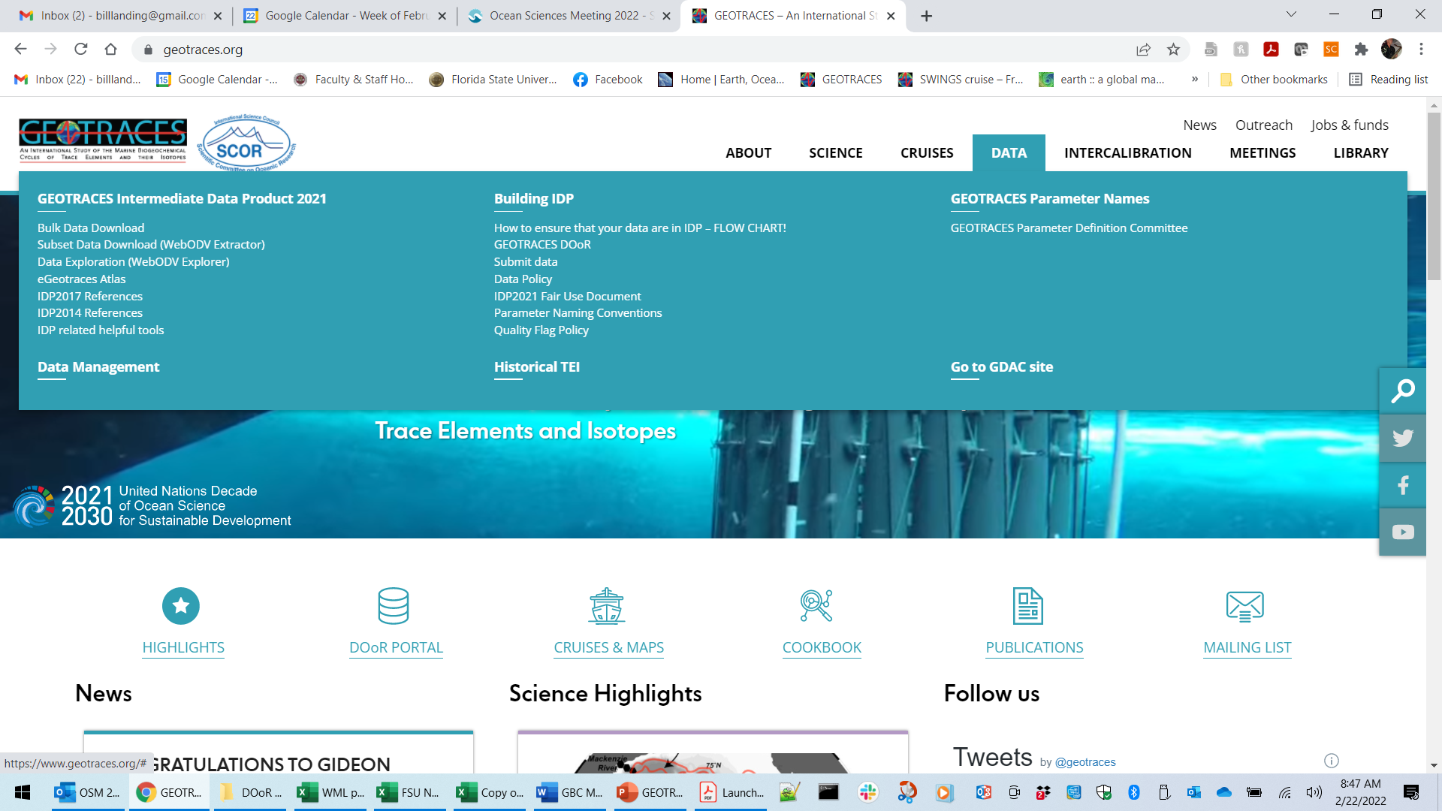

Slide 3
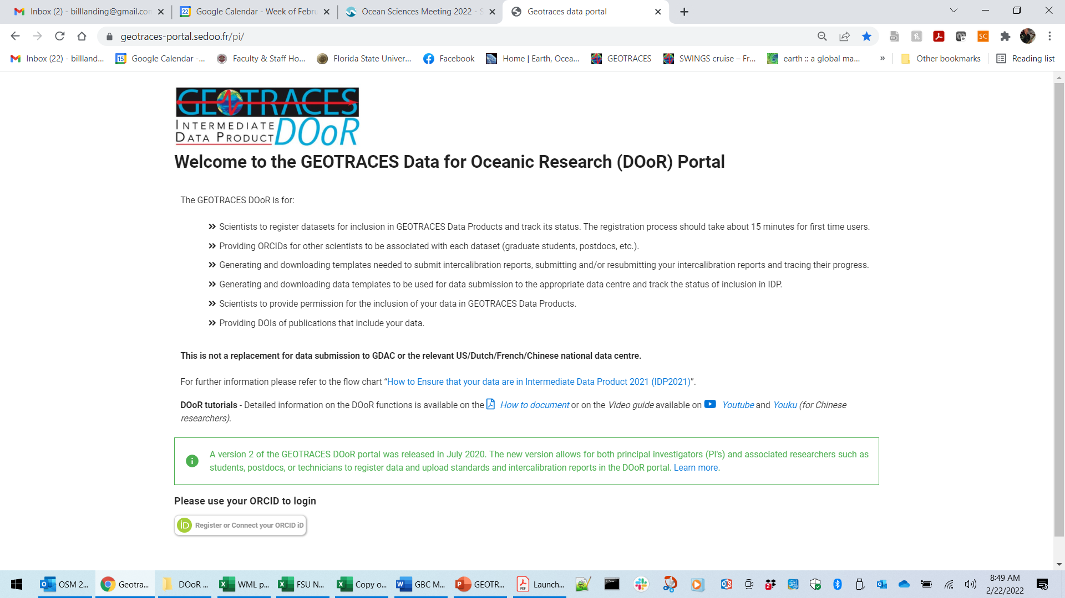
The DOoR portal is the place to register the datasets you want to have included in the next IDP.

Slide 4
The DOoR is not used to submit your actual data files.
You must submit your data to the relevant US, Dutch, French, or Chinese national data centers or to the GEOTRACES Data Assembly Centre (GDAC at BODC), preferably using the data submission template you can download in Step 3.2

Slide 5
The software generates a database of scientists, cruises, and parameters so that we can track the entire process of registering data for the next IDP.

Slide 6
There are links to a PDF tutorial and a video tutorial.
Highly recommended!

Slide 7
Click “Please use your ORCID to login.”
If you don’t have an ORCID ID, you will be prompted to register for one.
This is required.

Slide 8
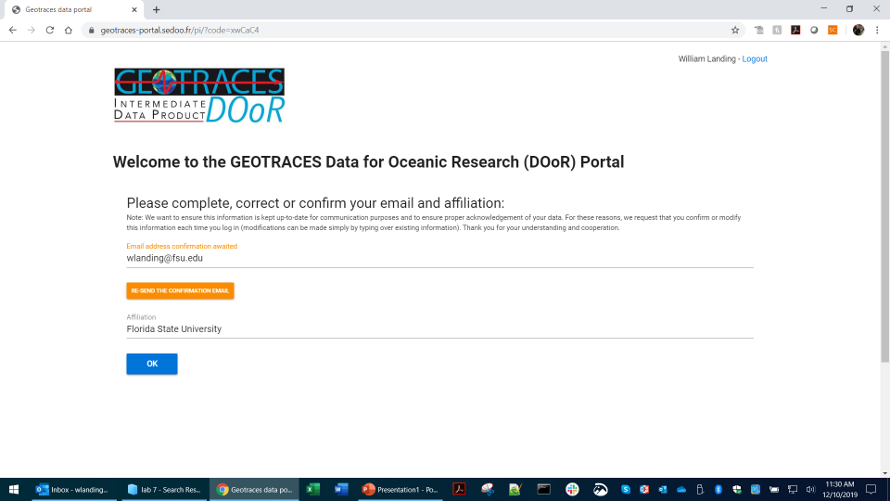
The first time you log in you will need to enter your institutional email and affiliation.
You need to confirm this each time you log in so we can maintain an accurate list of DOoR users.
Click “OK” when the information is correct.

Slide 9
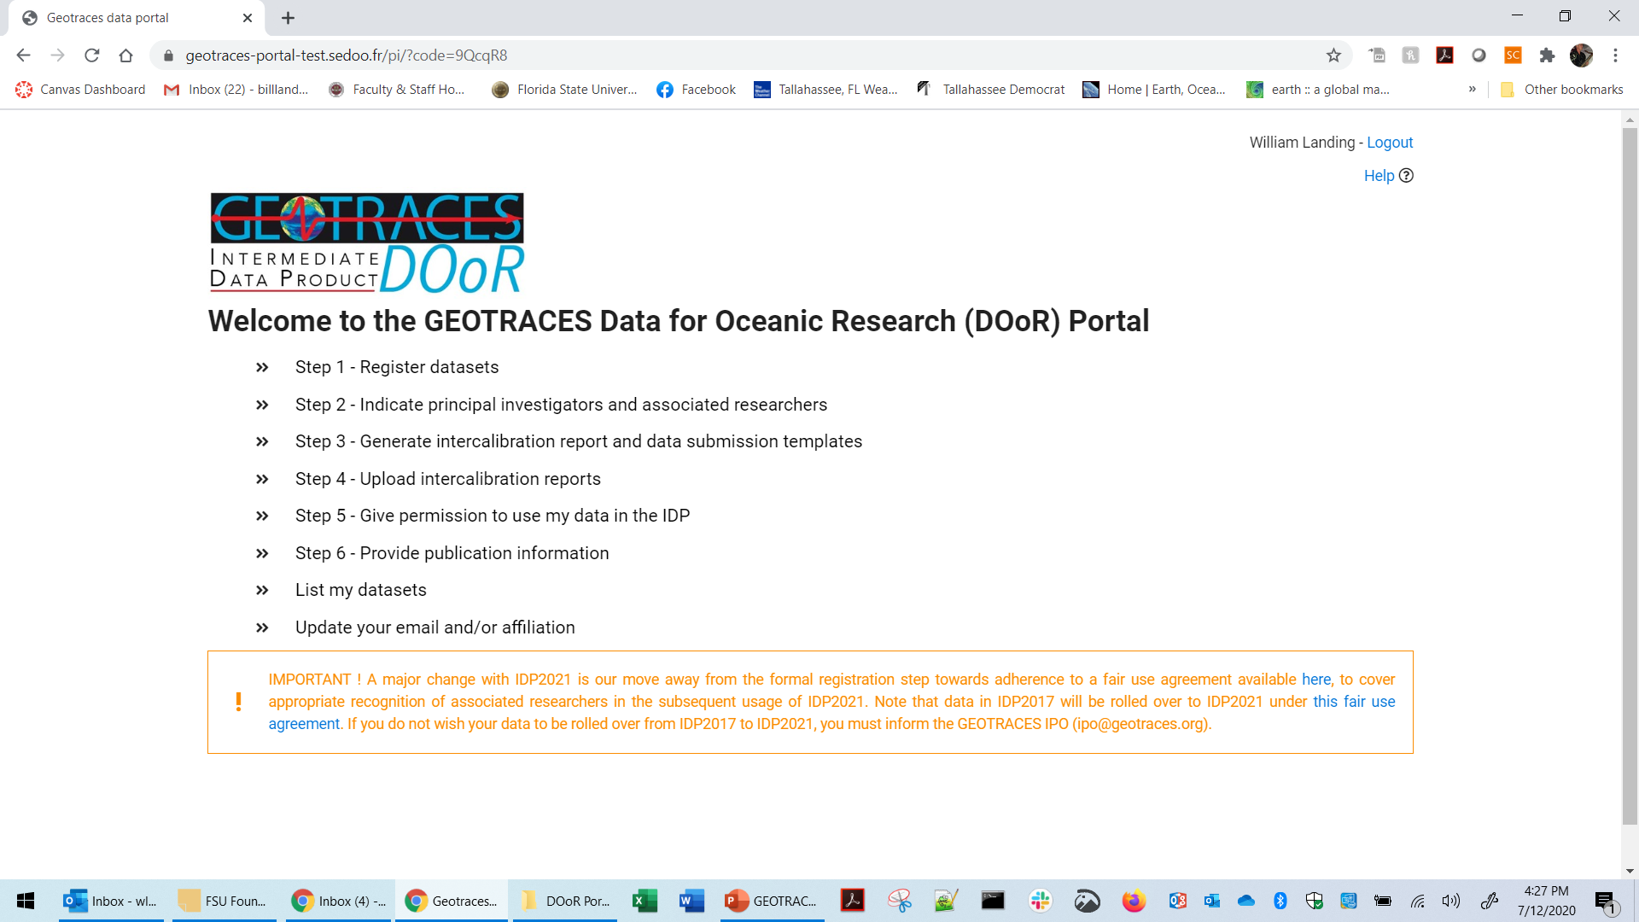
Please note the IMPORTANT announcement that we changed from a required “registration step” to the Fair Use Agreement for people to access data in IDP2021 and in future GEOTRACES IDPs.
Please click the link to read the Fair Use Agreement and understand its intentions and applications

Slide 10
Step 1: The first step is to identify the datasets you want to register.
There are many steps to register a dataset, too many to cover in this short presentation.
Please watch the video tutorial and read the PDF tutorial where each step is explained.
Very briefly, you can register datasets from a GEOTRACES cruise or “compliant” data that meet certain criteria.
You can select your cruise and your parameters from our extensive lists.

Slide 11
For GEOTRACES data products, a dataset is defined on a cruise-by-cruise basis and on a parameter-by-parameter basis (because this is how the Intercalibration process is organized).
When a dataset may have been generated by more than one scientist, each scientist can register their portion of the dataset or one of the scientists can assume the responsibility for registering the entire dataset on behalf of the other scientists.
Please contact the GEOTRACES Data Assembly Center (GDAC) at BODC (geotraces.dac@bodc.ac.uk) if you have questions about this.

Slide 12
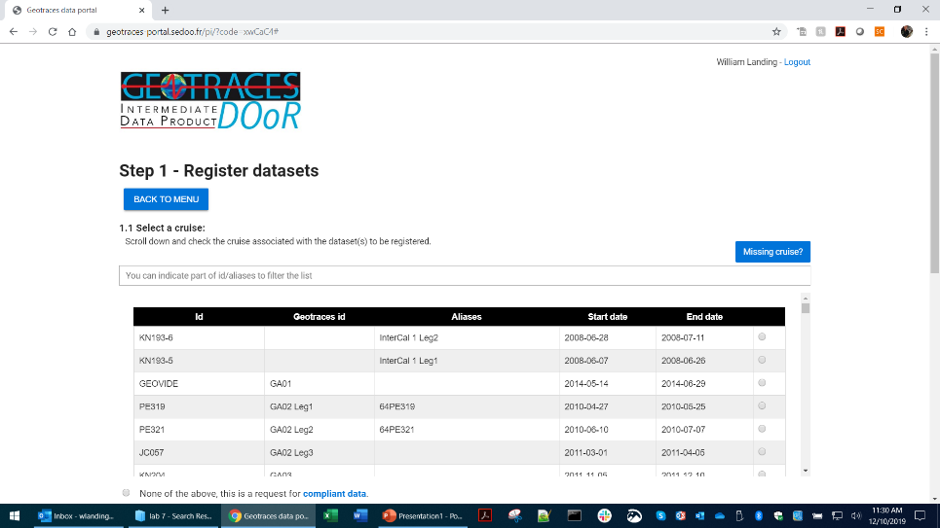
Step 1.1: Select a Cruise
You can scroll through the list of GEOTRACES cruises, or search using part of the cruise ID, GEOTRACES ID, or cruise alias.

Slide 13
If you want to register “Compliant Data”, click the button and provide the cruise ID or give an alias to the cruise.
More details at: https://www.bodc.ac.uk/geotraces/cruises/
And:
https://www.geotraces.org/wp-content/uploads/2020/10/IDP2021_Guide_for_cruise_Oct20.pdf

Slide 14
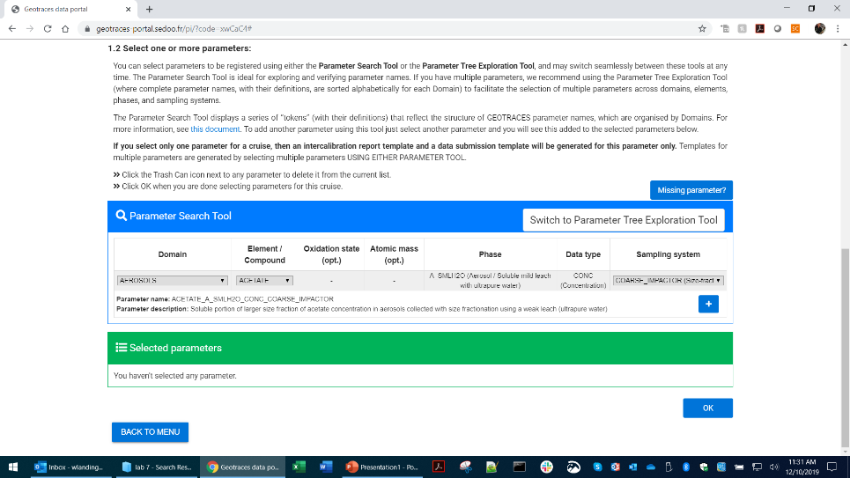
Step 1.2: After selecting your cruise:
Select the parameters/datasets you want to register.
There are two ways to select your parameters; the Parameter Search Tool and the Parameter Tree Exploration Tool.
Use either method, or both!
Click the blue + button to add parameters to your list.

Slide 15
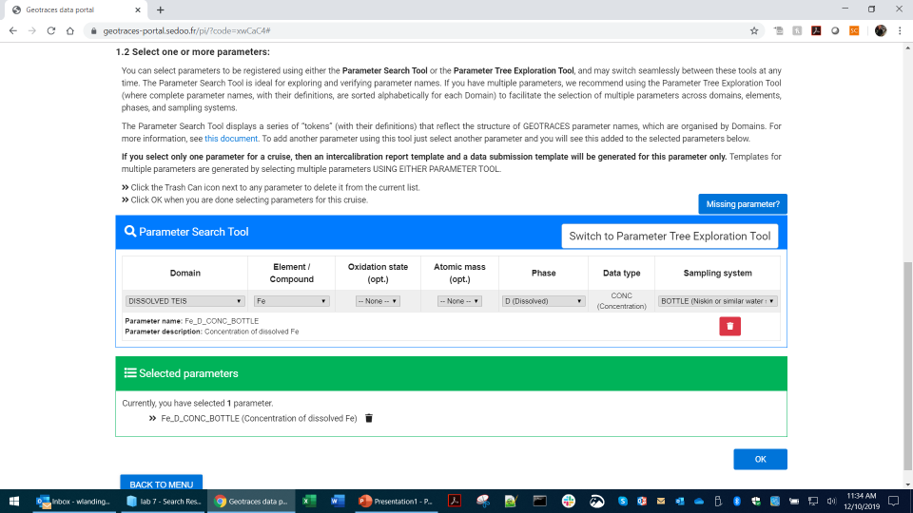
Step 1.2 (cont.)
Your parameters will appear in a list below.
Once you have selected all the parameters you want to register for this cruise, click the blue OK button and a popup will appear.

Slide 16
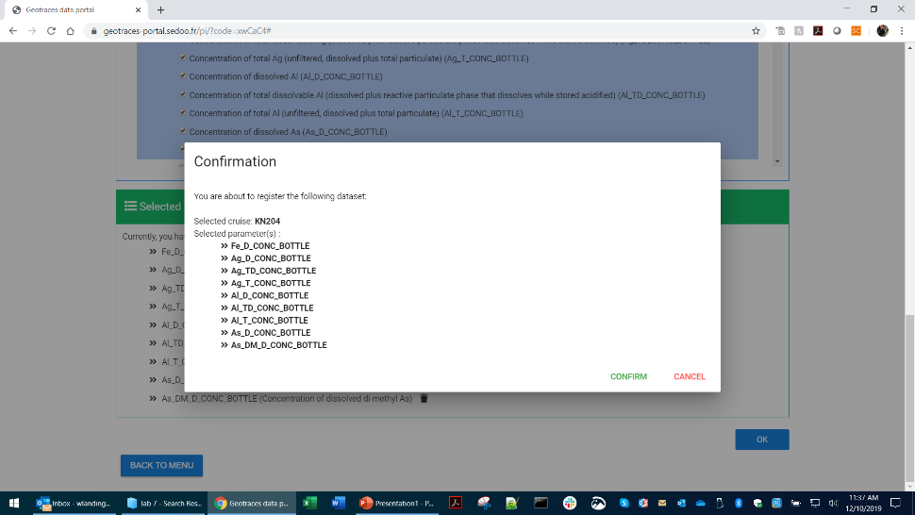
Step 1.2 (cont.)
If you CONFIRM, this will create dataset registrations where each parameter is assigned a unique 6-digit “bar-code”, linking each parameter with a particular cruise and with the scientist who is registering the dataset.

Slide 17
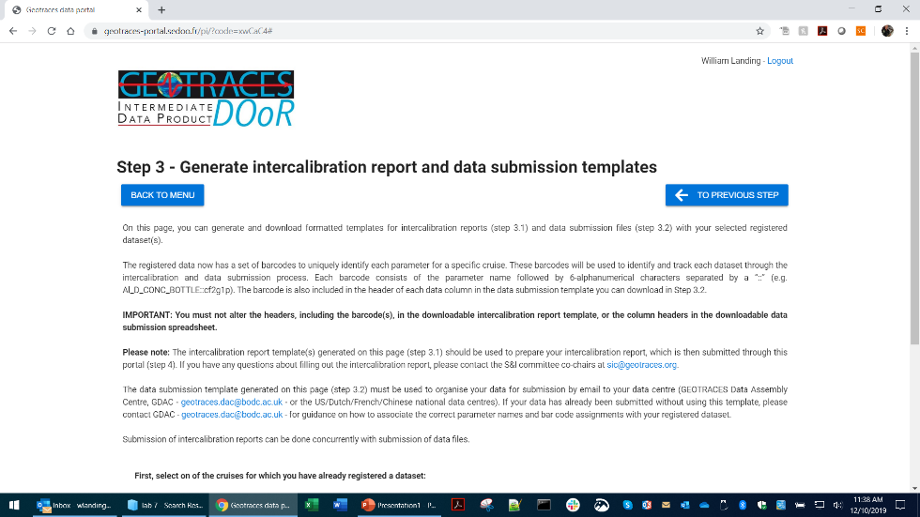
Skipping Step 2 for the moment, go to Step 3:
Step 3: Generating intercalibration report and data submission templates.
Ensuring the accuracy, reliability, and inter-comparability of the data is an essential component of GEOTRACES.
This is supervised by the Standards and Intercalibration Committee (S&I).
S&I works with PIs and data generators to produce datasets of the highest possible quality.
Read the general instructions for preparing intercalibration reports.

Slide 18
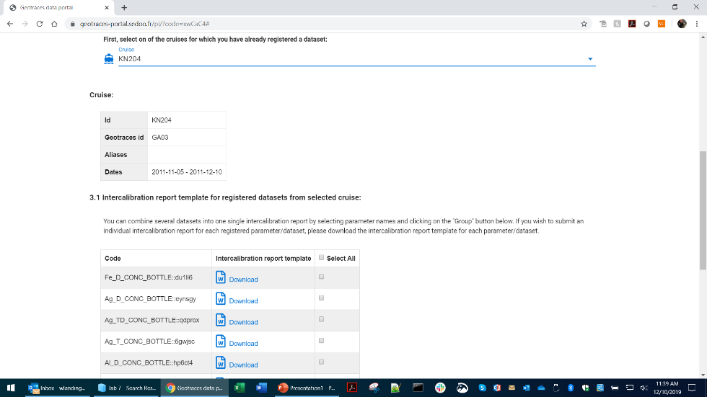
Scroll down to select the cruise where you have registered datasets, and a list of those datasets will appear, showing the parameter name and the unique barcode that was attached to it.
It is essential that you retain the unique headers and barcodes that associate you (the data submitter) with each cruise and each parameter in your datasets. These barcodes will be used to track each parameter in each dataset through every step.
You can download Intercalibration report templates for each parameter.

Slide 19
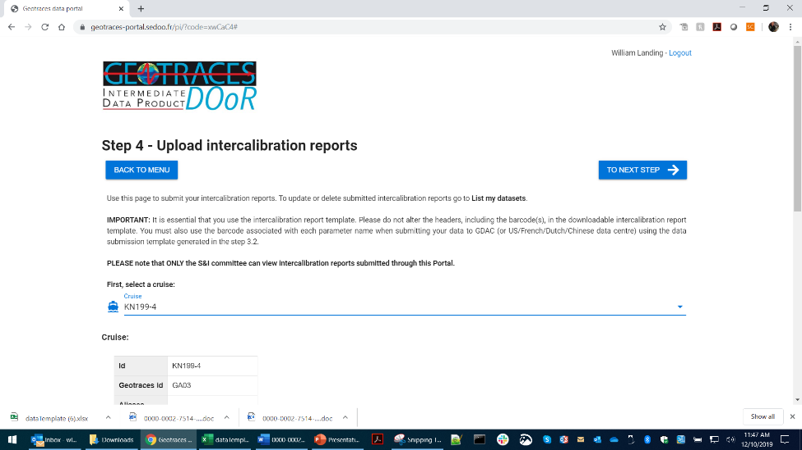
Step 4: Uploading Intercalibration reports
You must use the Intercalibration report template files that you downloaded in Step 3.1
These will be reviewed by the GEOTRACES Standards and Intercalibration Committee (S&I).
Click the “Cruise” line to select a cruise for which you registered one or more datasets.
Upload Intercalibration reports for each dataset.

Slide 20
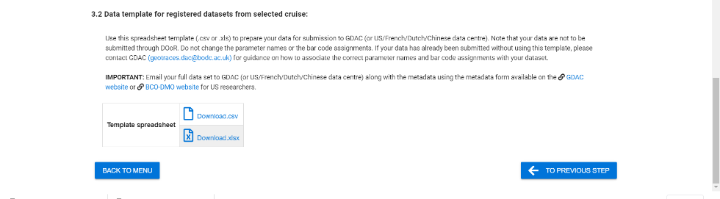
Step 3.2: Data submission template files
You can download Data Submission template files (Excel or .csv text format) that will show your dataset registrations and every parameter (with its barcode).
This template should be used to submit your actual data to the US, Dutch, French, or Chinese data center or to GDAC, because it contains the correct GEOTRACES parameter names and units and has the barcodes that allow us to track each dataset.

Slide 21
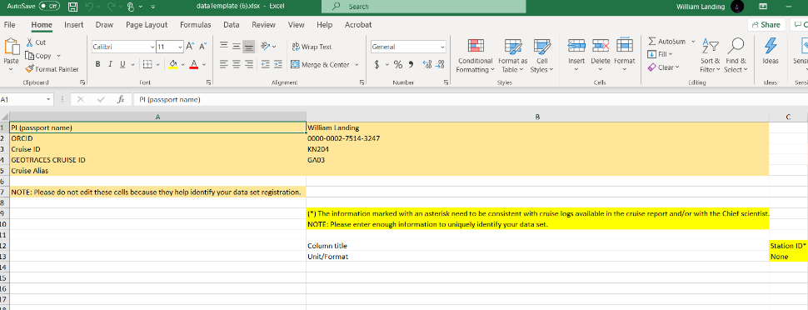
Step 3.2: The data submission template.
The data submission template includes some metadata for each cruise.
Please pay attention to the notes about NOT changing or editing certain cells.

Slide 22
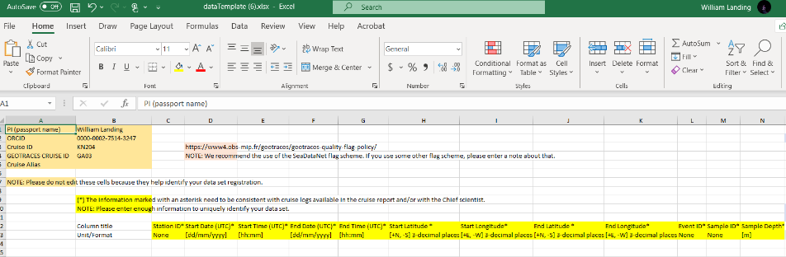
We recommend using the SeaDataNet quality flag scheme: https://www.seadatanet.org/
Enter information that is consistent with your cruise logs and cruise reports in the yellow highlighted columns. The goal is to enter enough information to uniquely identify your dataset.

Slide 23
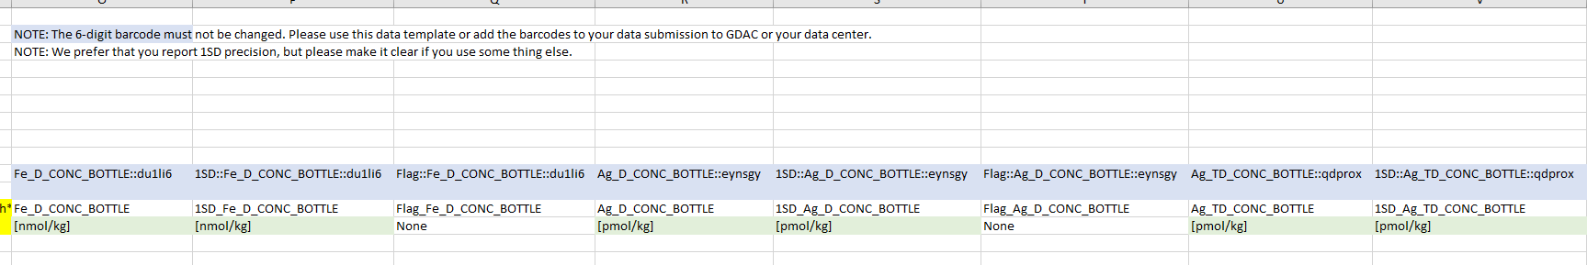
Scroll to the right in the data submission template to see the parameter names and barcodes.
Do not edit the headers or the barcodes!
You should enter the actual data for each parameter (in the preferred units), the precision of the measurements (1SD preferred), and the data quality flag.
After putting your data into this file, submit it to the US, Dutch, French or Chinese data center (or to GDAC).
If you have already submitted your data to your national data center (or to GDAC at BODC), we recommend that you contact Mohamed Adjou (GDAC, geotraces.dac@bodc.ac.uk) to discuss the most efficient way to associate your actual data with the parameter/datasets you are registering using the DOoR.
The result may be that you use this data submission template to re-submit your data. This is actually very easy to do!

Slide 24
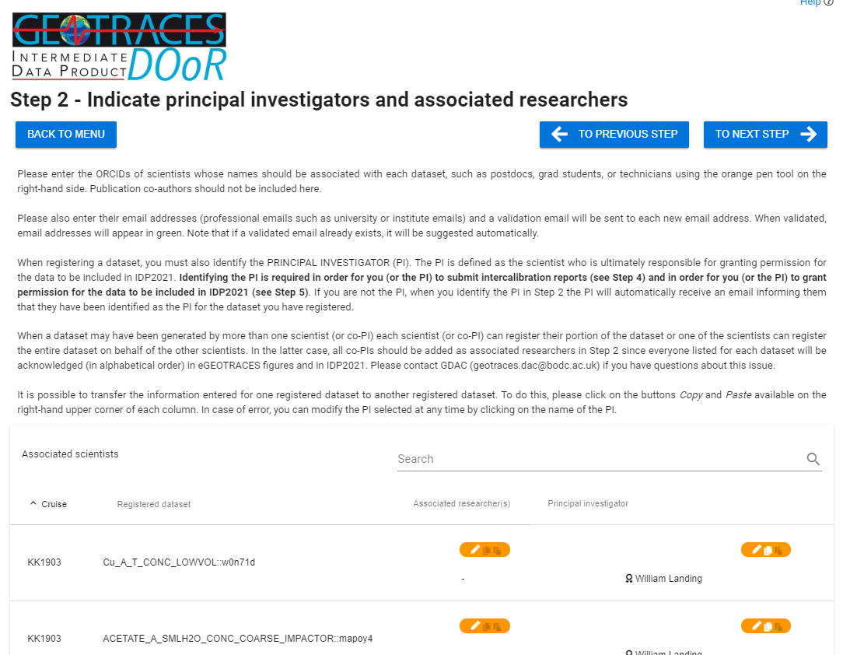
Back to Step 2 – Indicate principal investigators and associated researchers.
In Step 2, you will see a list of all your datasets where each parameter is associated with a given cruise.
The goal is to have links between the PIs and the data generators, the grad students, the postdocs, etc. who were responsible for a given dataset, using ORCIDs to maintain those links.
You can return to Step 2 at any time to complete or modify this information.

Slide 25
Click the orange pencil icons to add the PI and the data generators for each dataset, cruise-by-cruise and parameter-by-parameter.
You will need the ORCIDs and institutional email addresses of those people.

Slide 26
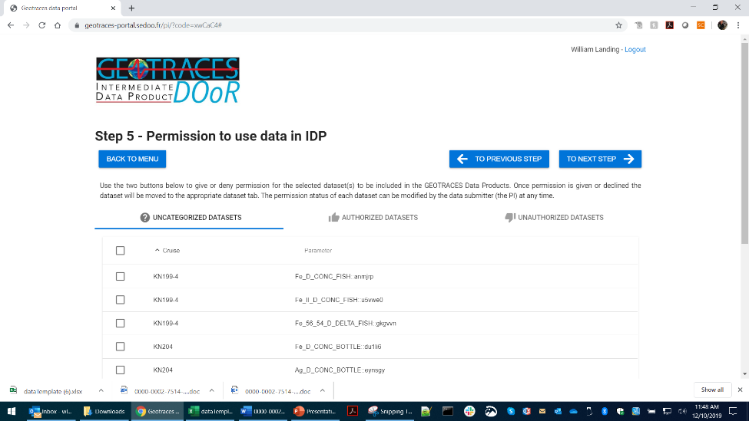
Step 5: Granting permission to use data in the next GEOTRACES IDP.
The PI can select data sets (cruise-by-cruise and parameter-by-parameter) to grant permission for those data to be included in an IDP.
You can change this selection at any time if your change your mind.

Slide 27
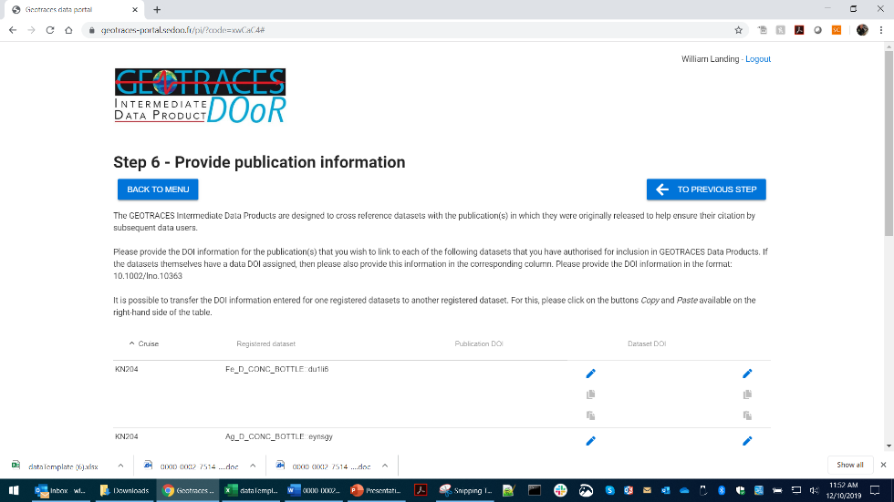
Step 6: Provide publication information
Please enter any publication or dataset DOIs here so we can add them to the publication database maintained at the IPO and ensure that your data are correctly cited.
If publications are not yet available, return to this page when they are published to link them to your IDP data.

Slide 28
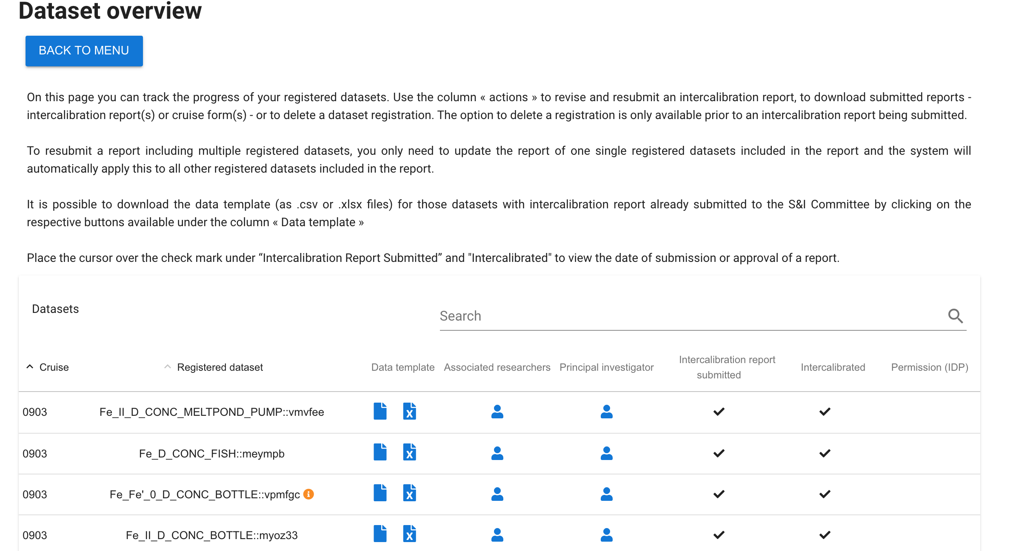
List My Datasets:
You can follow the progress of each dataset you have registered from the “List my datasets” link on the main menu.
For example, You can review which scientists have been linked to each dataset.
You can see when the S&I committee has approved your intercalibration report.

Slide 29


Slide 30
The GEOTRACES DOoR portal
If you have any questions about this guide, please contact:
Elena Masferrer-Dodas (ipo@geotraces.org).
Bill Landing (wlanding@fsu.edu).

