Slide 1
INTRODUCTION TO THE GEOTRACES INTERMEDIATE DATA PRODUCT 2021
Catherine Jeandel
GEOTRACES IPO senior scientist

Slide 2
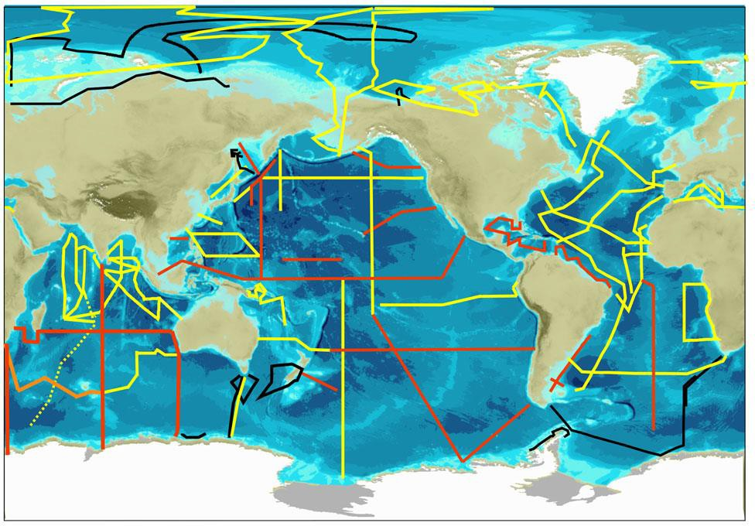
GEOTRACES MISSION
GEOTRACES mission is to identify processes and quantify fluxes that control the distributions of key trace elements and isotopes (TEIs) in the ocean, and to establish the sensitivity of these distributions to changing environmental conditions
Scientists from more than 35 nations have been involved in the programme, which is designed to study all major ocean basins
To date:
35 nations
131 cruises completed
43 sections completed
1,721 publications
3 open source data products released in 2021, 2017 and 2014
2

Slide 3
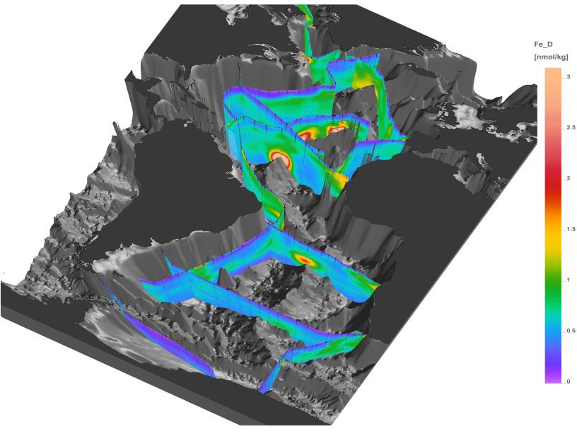
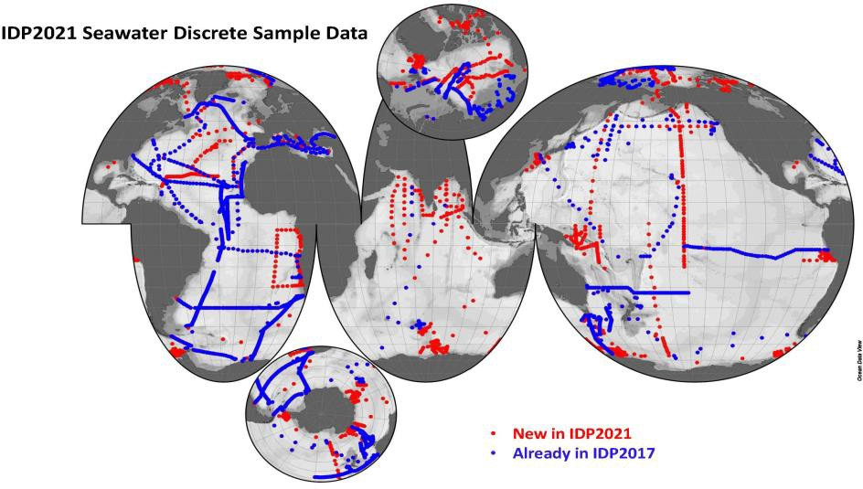
GEOTRACES IDP2021
By releasing and sharing more hydrographic and marine geochemical high-quality data from 77 cruises, we wish to strengthen and intensify the collaboration within the marine geochemical community itself, but also invite colleagues from other communities to join us.
IDP2021 consists on:
(1) a compilation of digital trace metal data 100,000 samples from 77 cruises (geotraces.org/dp) | (2) the eGEOTRACES Electronic Atlas (egeotraces.org)
Dissolved Fe in the Atlantic Ocean
3

Slide 4
HIGH-QUALITY DATA = INTERCALIBRATION
www.geotraces.org
@geotraces
#OceanData #OceanScience
4

