Slide 1
Exploration: linkinG TEI & geNomics data in IDP2021
We wish to strengthen and intensify the collaboration between the marine geochemical community and the biological / omics’ community.
GEOTRACES
Sections
with omics data
GA02
GA03
GA10
GP13
Berube et al. 2018 http://doi.org/10.1038/sdata.2018.154
Notes:
Exploration: linkin TEI and genomics data in EIDP2021
Single cell trace metal quotas
Targeted Metaproteomics
HPLC pigments
nifH gene copies
EMBL_EBI_Metagenome_MGNIFY_Analysis_Accession: Derived functional and taxonomic analysis of the metagenomic data provided by the "NCBI_Metagenome_BioSample_Accession" parameter. The MGnify accession URL directs the user to a site where an automated analysis of taxonomic and functional diversity can be explored. The entire 2018 study set can be accessed at https://www.ebi.ac.uk/metagenomics/studies/MGYS00005294
NCBI_Metagenome_BioSample_Accession: NCBI BioSample accession number for the metagenomic data associated with this bottle number. See: https://www.ncbi.nlm.nih.gov/biosample/
NCBI_Single-Cell-Genome_BioProject_Accession: NCBI BioProject accession number for single cell genomics data of Bacteria and Archaea. These BioProjet accession numbers encompass single cell genomes from multiple bottles. See the associated Digital Object Identifiers (DOI) for primary references. See https://www.ncbi.nlm.nih.gov/bioproject/
NCBI_16S-18S-rRNA-gene_BioSample_Accession: NCBI BioSample accession numbers for 16S/18S rRNA gene amplicon sequences (i.e., universal SSU rRNA amplicon V4-V5 DNA for high resolution taxonomy) associated with this bottle number. See: https://www.ncbi.nlm.nih.gov/biosample/

Slide 2
Exploration: linkinG TEI & genomics data in IDP2021
A major challenge, as the omics data is dynamic (changes depending on ever-growing genome reference databases) while the TEI data is static.
Acknowledgements to:
Reiner Schiltzer (AWI)
Paul Berube (MIT)
Jesse McNichol (U. Southern California)
And many others who made this possible, specially members of
Penny Chisholm lab
4 Types of Sample Descriptors for omics data linkages in the IDP2021:
to NCBI website
480 Metagenomes
14 Single-Cell genomes
273 16S-18S-rRNA gene analyses
to EMBL-EBI website
480 16S/18S amplicons (microbial community taxonomic & functional
structure and abundance)
Notes:
Exploration: linkin TEI and genomics data in EIDP2021
Single cell trace metal quotas
Targeted Metaproteomics
HPLC pigments
nifH gene copies
EMBL_EBI_Metagenome_MGNIFY_Analysis_Accession: Derived functional and taxonomic analysis of the metagenomic data provided by the "NCBI_Metagenome_BioSample_Accession" parameter. The MGnify accession URL directs the user to a site where an automated analysis of taxonomic and functional diversity can be explored. The entire 2018 study set can be accessed at https://www.ebi.ac.uk/metagenomics/studies/MGYS00005294
NCBI_Metagenome_BioSample_Accession: NCBI BioSample accession number for the metagenomic data associated with this bottle number. See: https://www.ncbi.nlm.nih.gov/biosample/
NCBI_Single-Cell-Genome_BioProject_Accession: NCBI BioProject accession number for single cell genomics data of Bacteria and Archaea. These BioProjet accession numbers encompass single cell genomes from multiple bottles. See the associated Digital Object Identifiers (DOI) for primary references. See https://www.ncbi.nlm.nih.gov/bioproject/
NCBI_16S-18S-rRNA-gene_BioSample_Accession: NCBI BioSample accession numbers for 16S/18S rRNA gene amplicon sequences (i.e., universal SSU rRNA amplicon V4-V5 DNA for high resolution taxonomy) associated with this bottle number. See: https://www.ncbi.nlm.nih.gov/biosample/

Slide 3
Exploration: linkinG TEI & genomics data in IDP2021
OMICs linkages
4 Sample Descriptors in the Metadata variables:
Accession numbers at NCBI or EMBL-EBI
Or links to functional and taxonomic analyses webpages
OMICs linkages in Metadata VARIABLES #:
11. NCBI_Metagenome_BioSample accession #:
13. NCBI_16S-18S-rRNA-gene_BioSample accession #:
@ https://www.ncbi.nlm.nih.gov/biosample/
12. NCBI_Single_cell_genome_BioProject accession #:
@ https://www.ncbi.nlm.nih.gov/bioproject/
14. EMBL_EBI_Metagenome_MGNIFY_Analysis_Accession #:
@https://www.ebi.ac.uk/metagenomics/analyses/MGYA
Notes:
Exploration: linkin TEI and genomics data in EIDP2021
Single cell trace metal quotas
Targeted Metaproteomics
HPLC pigments
nifH gene copies
EMBL_EBI_Metagenome_MGNIFY_Analysis_Accession: Derived functional and taxonomic analysis of the metagenomic data provided by the "NCBI_Metagenome_BioSample_Accession" parameter. The MGnify accession URL directs the user to a site where an automated analysis of taxonomic and functional diversity can be explored. The entire 2018 study set can be accessed at https://www.ebi.ac.uk/metagenomics/studies/MGYS00005294
NCBI_Metagenome_BioSample_Accession: NCBI BioSample accession number for the metagenomic data associated with this bottle number. See: https://www.ncbi.nlm.nih.gov/biosample/
NCBI_Single-Cell-Genome_BioProject_Accession: NCBI BioProject accession number for single cell genomics data of Bacteria and Archaea. These BioProjet accession numbers encompass single cell genomes from multiple bottles. See the associated Digital Object Identifiers (DOI) for primary references. See https://www.ncbi.nlm.nih.gov/bioproject/
NCBI_16S-18S-rRNA-gene_BioSample_Accession: NCBI BioSample accession numbers for 16S/18S rRNA gene amplicon sequences (i.e., universal SSU rRNA amplicon V4-V5 DNA for high resolution taxonomy) associated with this bottle number. See: https://www.ncbi.nlm.nih.gov/biosample/

Slide 4
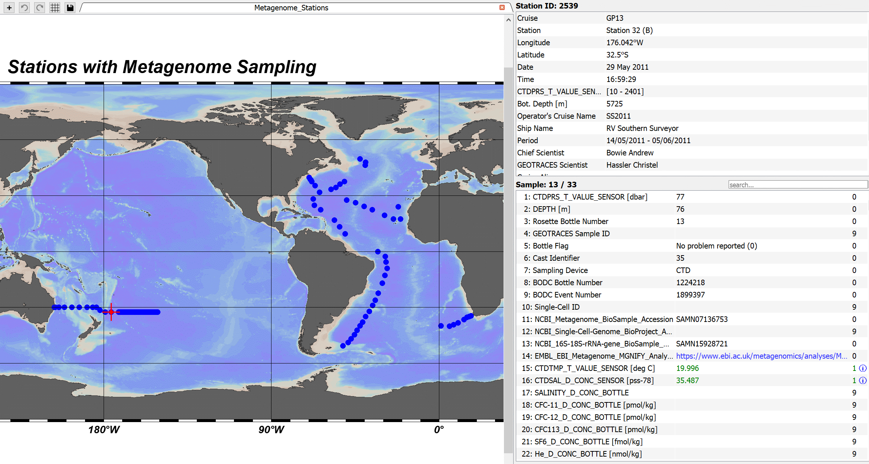
Exploration: linkinG TEI & genomics data in IDP2021
OMICs linkages
4 Sample Descriptors in the Metadata variables:
Accession numbers at NCBI or EMBL-EBI
Or links to functional and taxonomic analyses webpages
Notes:
Exploration: linkin TEI and genomics data in EIDP2021
Single cell trace metal quotas
Targeted Metaproteomics
HPLC pigments
nifH gene copies
EMBL_EBI_Metagenome_MGNIFY_Analysis_Accession: Derived functional and taxonomic analysis of the metagenomic data provided by the "NCBI_Metagenome_BioSample_Accession" parameter. The MGnify accession URL directs the user to a site where an automated analysis of taxonomic and functional diversity can be explored. The entire 2018 study set can be accessed at https://www.ebi.ac.uk/metagenomics/studies/MGYS00005294
NCBI_Metagenome_BioSample_Accession: NCBI BioSample accession number for the metagenomic data associated with this bottle number. See: https://www.ncbi.nlm.nih.gov/biosample/
NCBI_Single-Cell-Genome_BioProject_Accession: NCBI BioProject accession number for single cell genomics data of Bacteria and Archaea. These BioProjet accession numbers encompass single cell genomes from multiple bottles. See the associated Digital Object Identifiers (DOI) for primary references. See https://www.ncbi.nlm.nih.gov/bioproject/
NCBI_16S-18S-rRNA-gene_BioSample_Accession: NCBI BioSample accession numbers for 16S/18S rRNA gene amplicon sequences (i.e., universal SSU rRNA amplicon V4-V5 DNA for high resolution taxonomy) associated with this bottle number. See: https://www.ncbi.nlm.nih.gov/biosample/

Slide 5
Metagenome Biosample accession numbers at NCBI
Example 1. Metagenome sample accession numbers at NCBI
www.ncbi.nlm.nih.gov

Slide 6
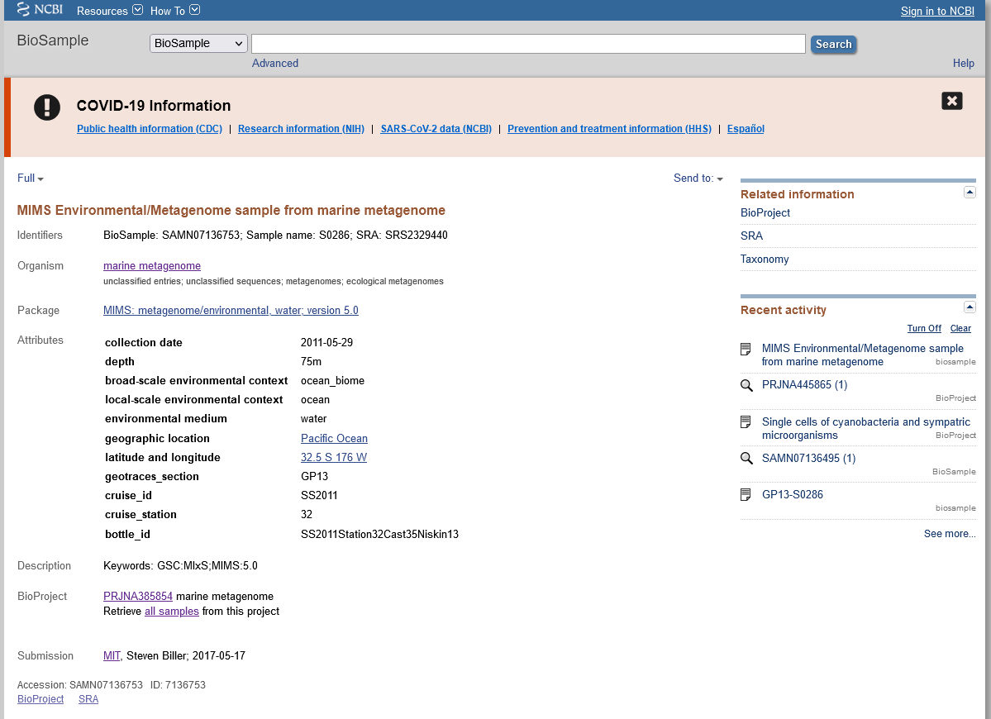
Metagenome Biosample accession numbers at NCBI
Example 1. Metagenome sample accession numbers at NCBI
www.ncbi.nlm.nih.gov

Slide 7
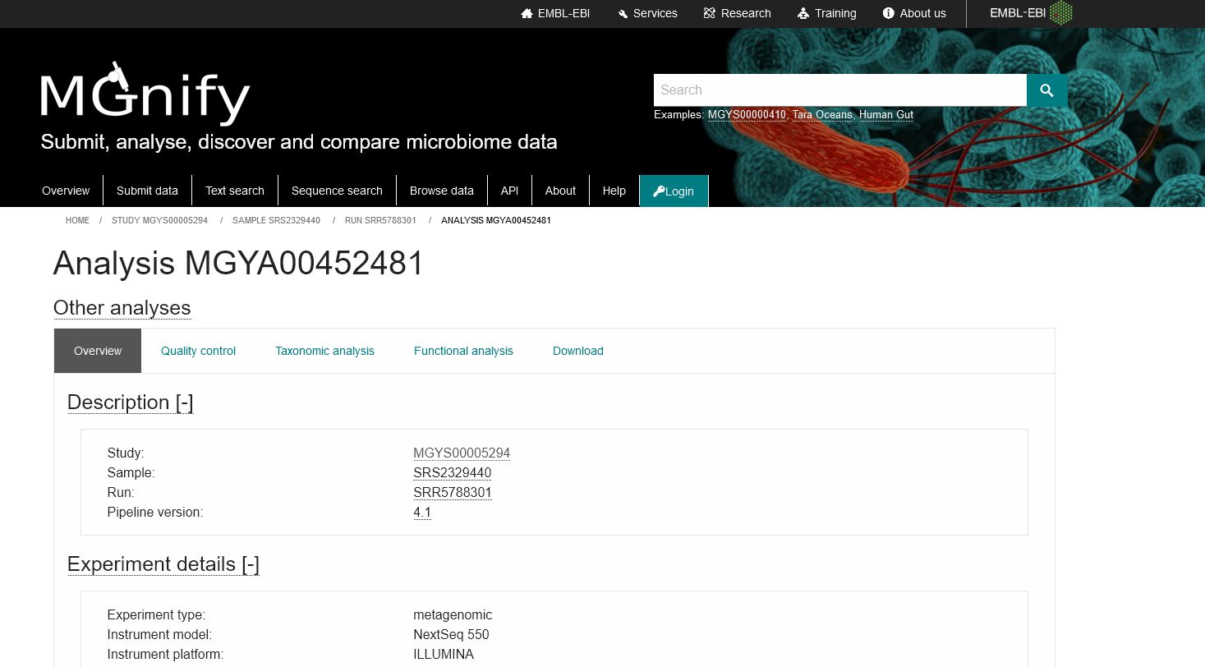
Functional & Taxonomic analyses EMBL-EBI
Example 2.
Functional & taxonomic analyses of metagenomes at EMBL-EBI
https://www.ebi.ac.uk/metagenomics/analyses/MGYA00452481#overview

Slide 8
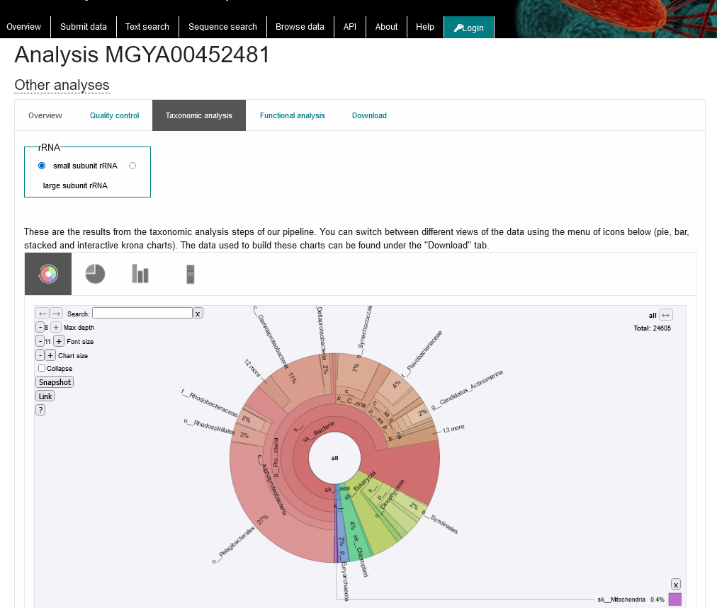
Functional & Taxonomic analyses EMBL-EBI
Example 2.
Functional & taxonomic analyses of metagenomes at EMBL-EBI
https://www.ebi.ac.uk/metagenomics/analyses/MGYA00452481#overview

Slide 9
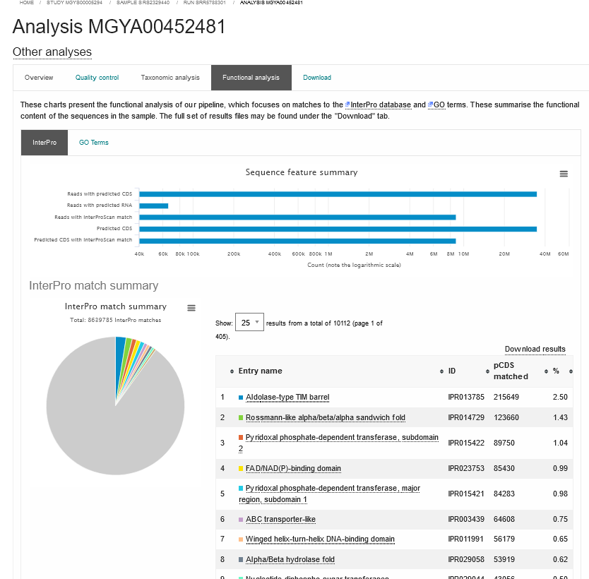
Functional & Taxonomic analyses EMBL-EBI
Example 2.
Functional & Taxonomic analyses of metagenomes at EMBL-EBI
https://www.ebi.ac.uk/metagenomics/analyses/MGYA00452481#overview

