Slide 1
ACCESSING THE GEOTRACES INTERMEDIATE DATA PRODUCT 2021
Reiner Schlitzer
Alfred Wegener Institute

Slide 2
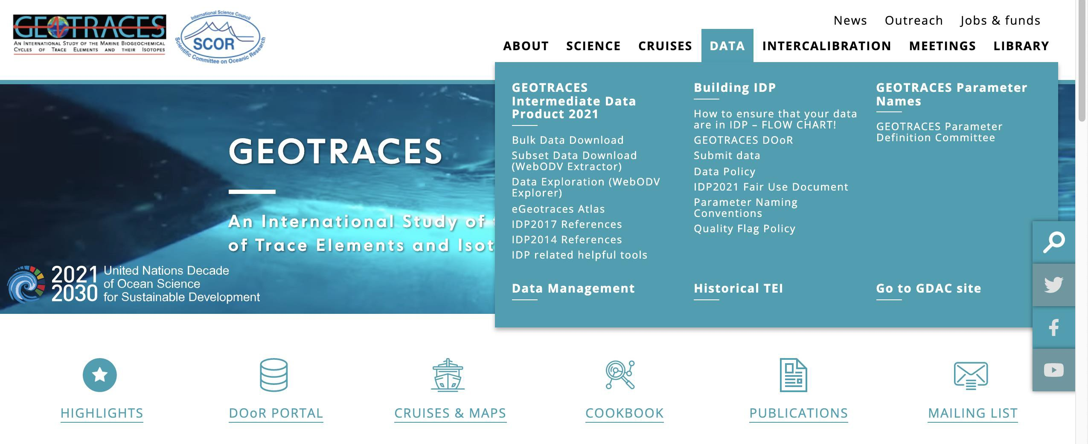
ACCESS THE IDP2021
www.geotraces.org
www.geotraces.org
#GEOTRACESDataProduct
#OceanData #OceanScience

Slide 3
ACCESS THE IDP2021: Reiner Schlitzer (AWI)
eGEOTRACES ATLAS
www.geotraces.org
www.geotraces.org
#GEOTRACESDataProduct
#OceanData #OceanScience

Slide 4
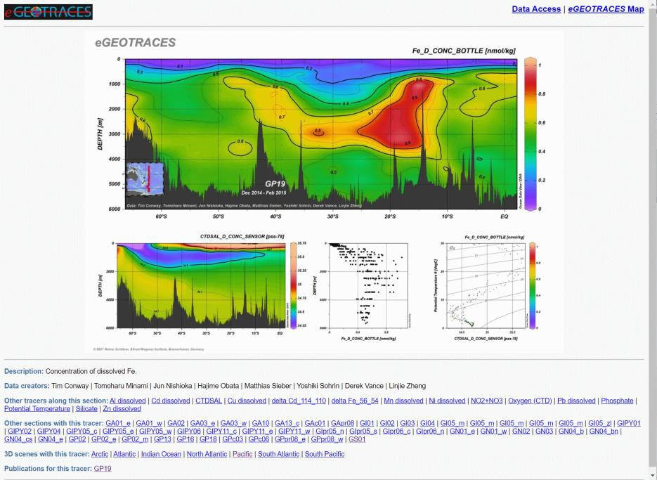
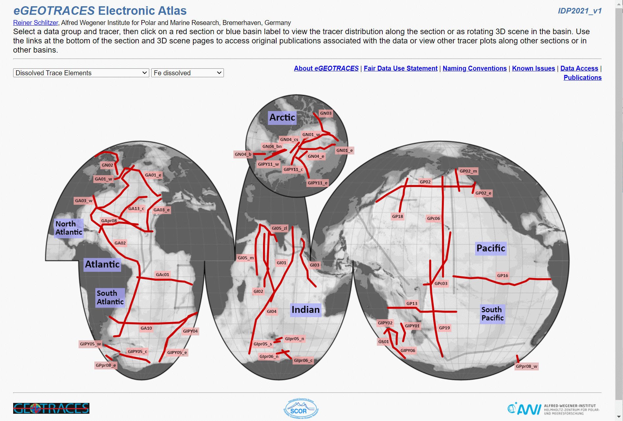
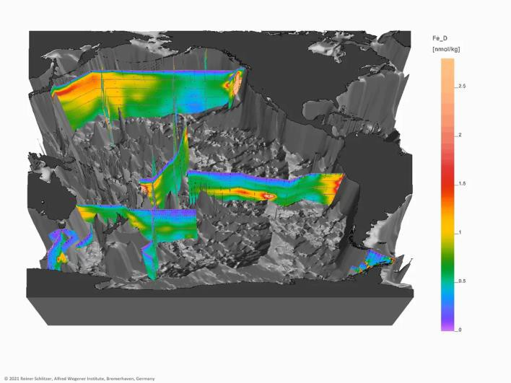
eGEOTRACES ATLAS
https://egeotraces.org/
1463 sections
269 3D scenes
www.geotraces.org
#GEOTRACESDataProduct
#OceanData #OceanScience

Slide 5
ACCESS THE IDP2021: DATA
www.geotraces.org
www.geotraces.org
#GEOTRACESDataProduct
#OceanData #OceanScience

Slide 6
IDP2021 DATA ACCESS
Bulk (full packages) download
Online subsetting and extraction
Online analysis and visualization
New: Agreement to the IDP2021 Fair Data Use Statement is required, but registration and login are no longer necessary.
www.geotraces.org
#GEOTRACESDataProduct
#OceanData #OceanScience

Slide 7
ACCESS THE IDP2021
www.geotraces.org
www.geotraces.org
#GEOTRACESDataProduct
#OceanData #OceanScience

Slide 8
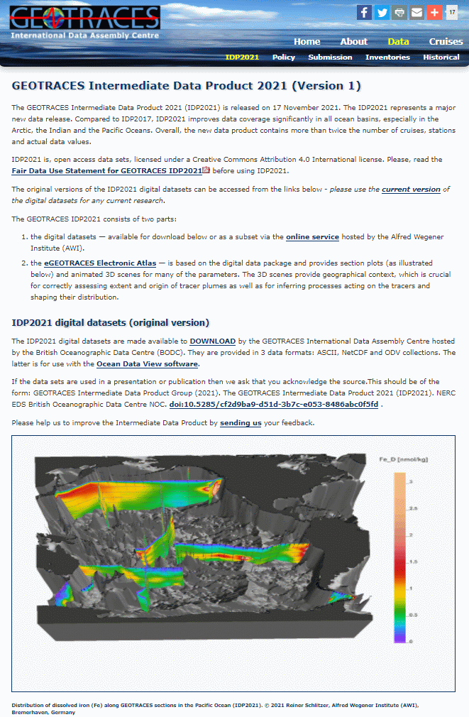
IDP2021 BULK DOWNLOAD
www.bodc.ac.uk/geotraces/data/idp2021/
Five Packages:
Seawater Discrete Sample Data Seawater Sensor Data
Aerosol Data Precipitation Data
Cryosphere Data
Three Formats:
csv ASCII netCDF
ODV collection
www.geotraces.org
#GEOTRACESDataProduct
#OceanData #OceanScience

Slide 9
ACCESS THE IDP2021
www.geotraces.org
www.geotraces.org
#GEOTRACESDataProduct
#OceanData #OceanScience

Slide 10
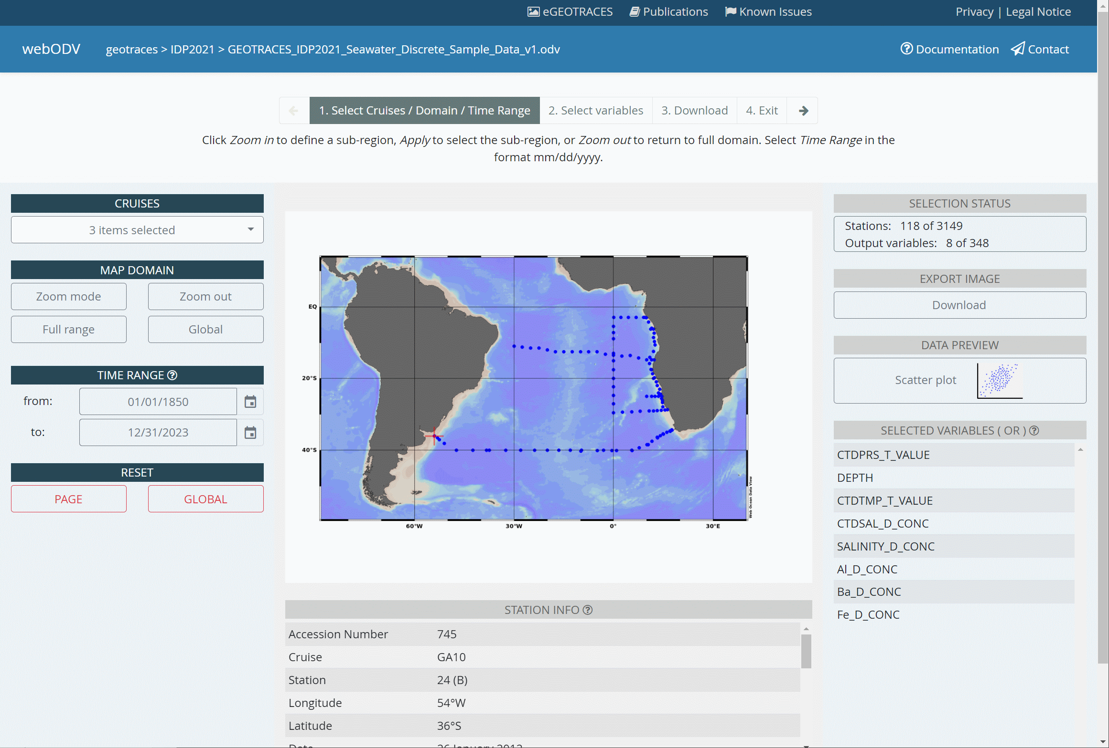
IDP2021 SUBSETTING AND EXTRACTION
geotraces.webodv.awi.de/
Select:
Cruises Domain
Time range
www.geotraces.org #GEOTRACESDataProduct
#OceanData #OceanScience ¹³

Slide 11
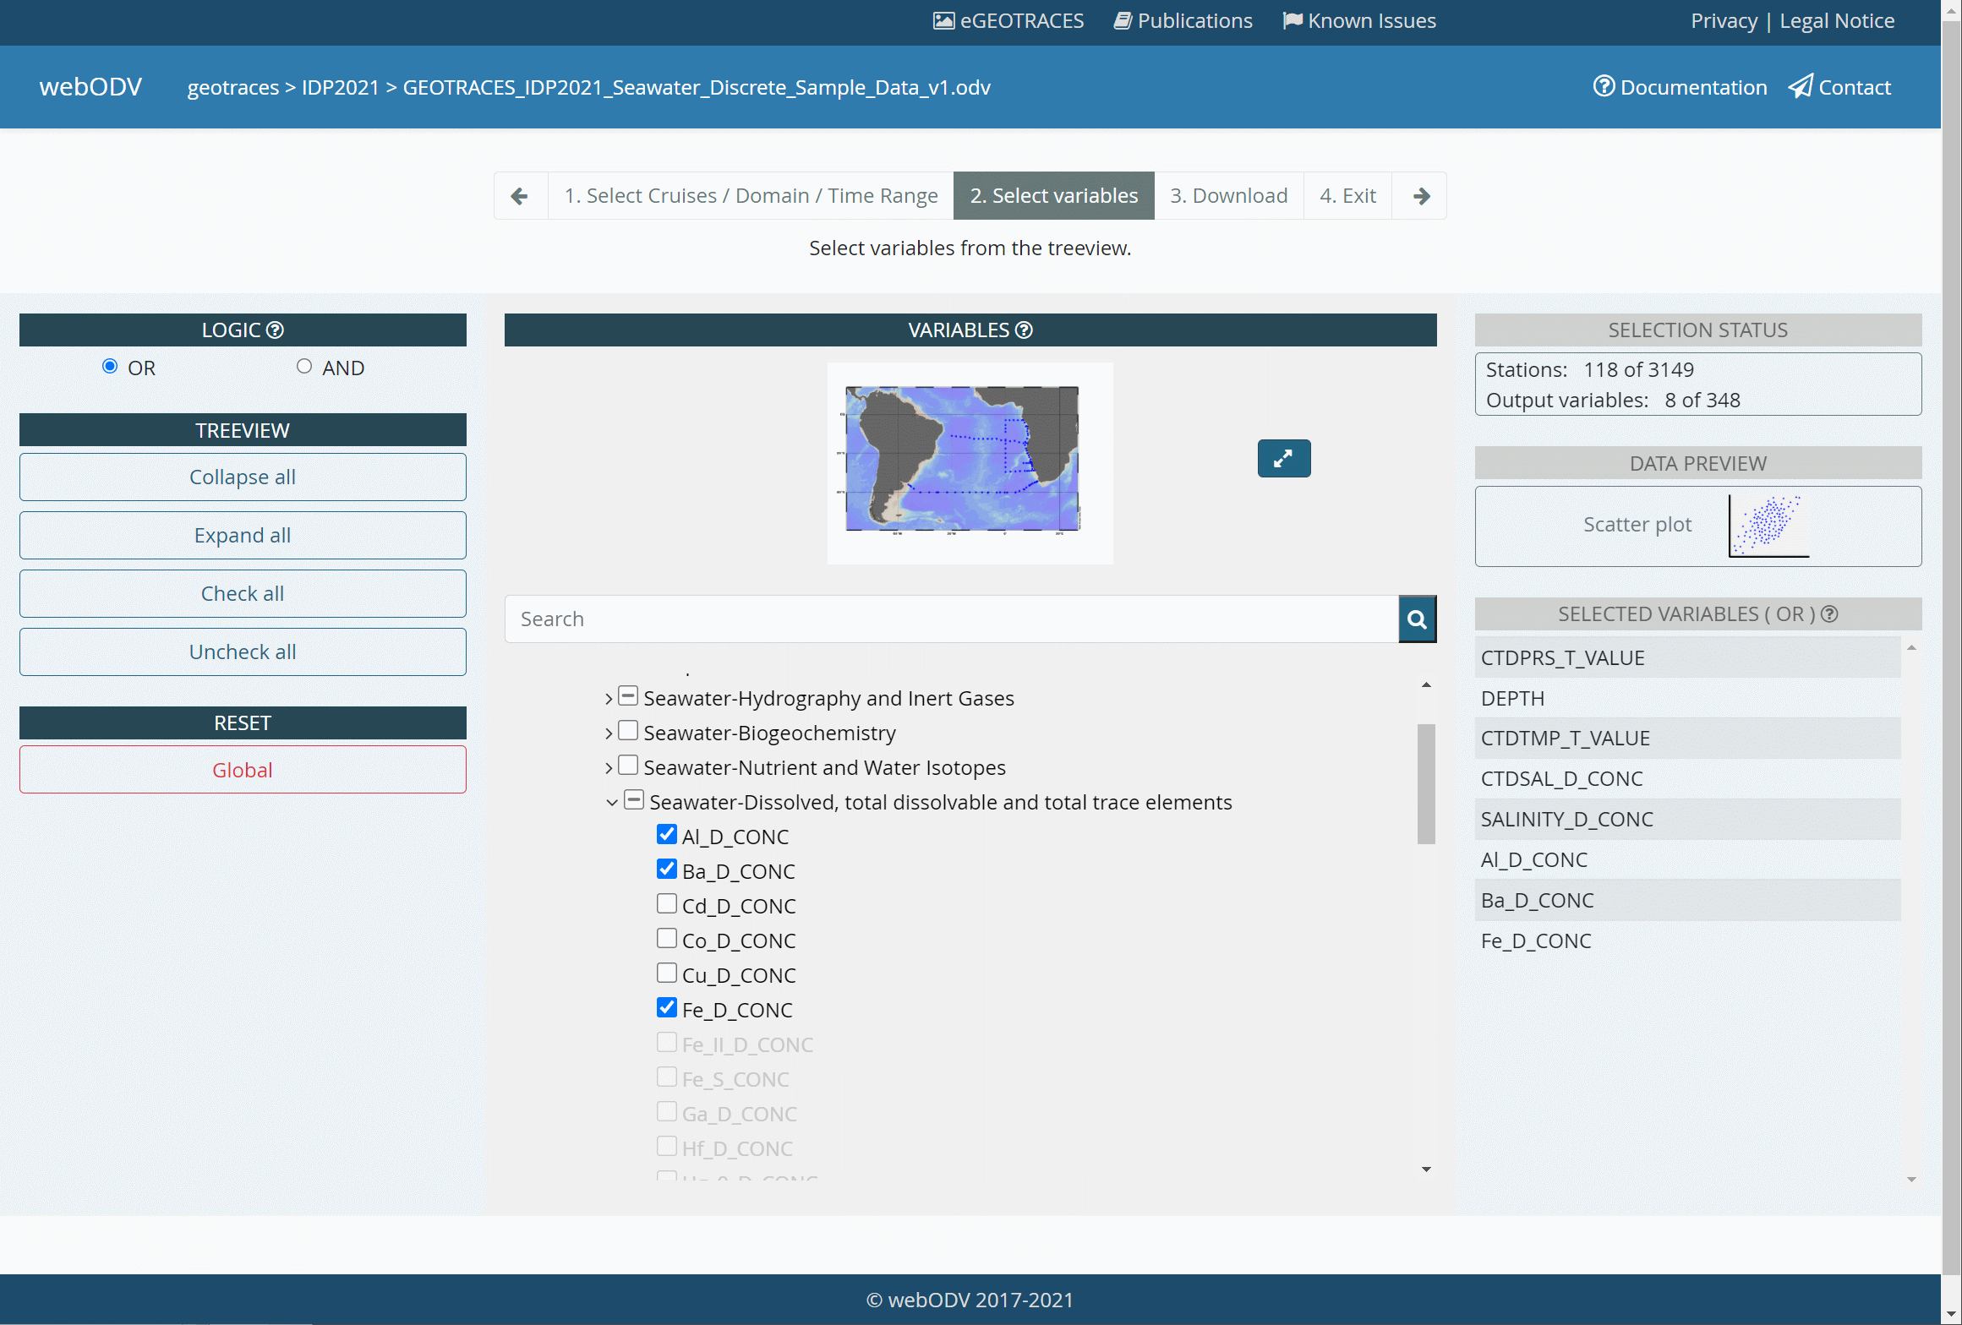
IDP2021 SUBSETTING AND EXTRACTION
geotraces.webodv.awi.de/
Select:
Variables (entire groups or indiv idual
entries)
www.geotraces.org #GEOTRACESDataProduct
#OceanData #OceanScience ¹⁴

Slide 12
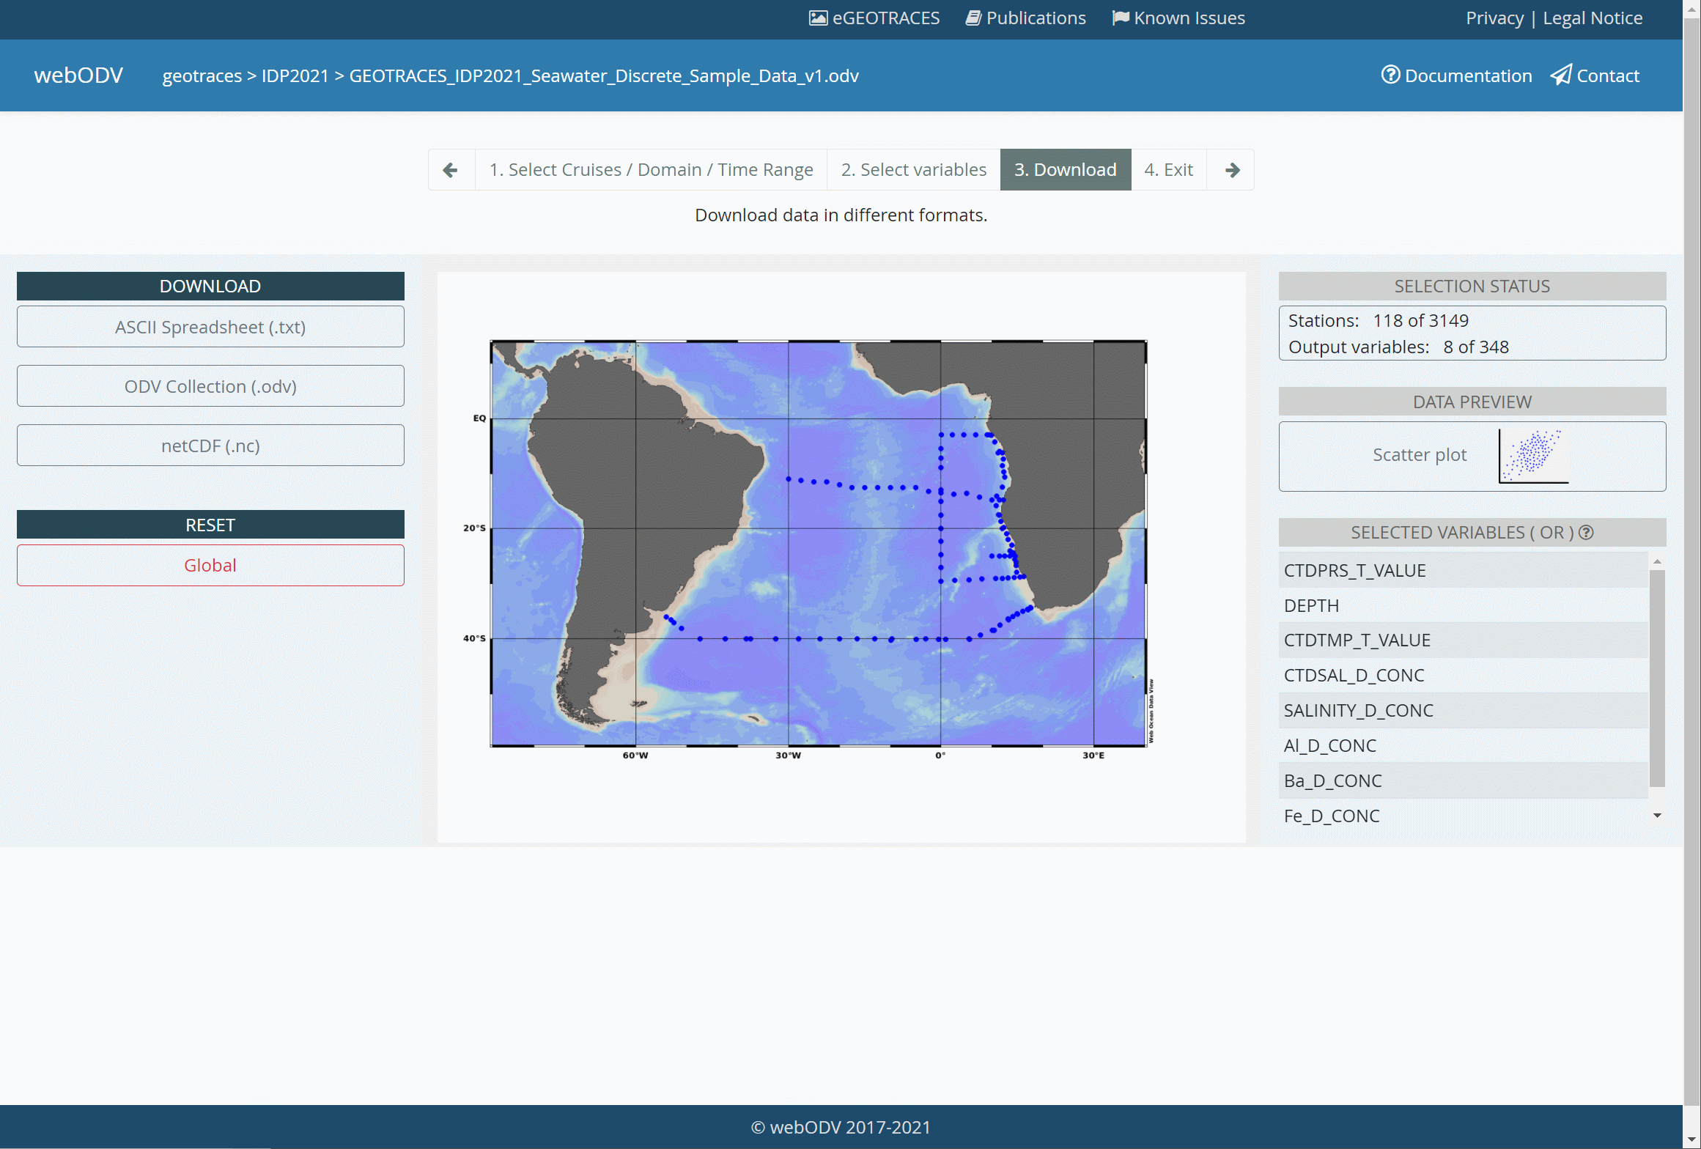
IDP2021 SUBSETTING AND EXTRACTION
geotraces.webodv.awi.de/
Select:
Output format
Receive:
Data subset as zip file
www.geotraces.org #GEOTRACESDataProduct
#OceanData #OceanScience ¹⁵

Slide 13
ACCESS THE IDP2021
www.geotraces.org
www.geotraces.org
#GEOTRACESDataProduct
#OceanData #OceanScience

