Slide 1
AUS & NZ
Voyage | Where | When | What | Contact (CS/GT) | Status
CANYONS | Cape Darnley, E. Antarctica | 03 Jan – 3 Mar 2022 | Proposed process study | Alix Post/Zanna Chase | scheduled
SOTS | ~140E/47S | 30 Apr – 12 May 2022 | Process study (time-series) | Elizabeth Shadwick/Zanna Chase | scheduled
INIV 2022 | ~140E to 55S | 23 May – 06 June | Nutrient intercomparison | Cassie Schwanger | scheduled
I9S (MISO) | Ice edge to Aus on ~115E | Jan – Feb 2023 | GEOTRACES section | Stephen Rintoul/Andrew Bowie | pending
Denman slope | Denman glacier region - slope | Jan – Feb 2023 or 2024 | Potential process study | Taryn Noble | pending
Marginal Ice Zone | MIZ, TBD | Sept-Oct 2023 | Potential process study | Petra Heil/Michael Ellwood | To be submitted. On RVIB Nuyina
Denman shelf | Denman glacier region - shelf | Jan 2025 | Potential process study | Helen Philips/Delphine Lannuzel | To be submitted. On RVIB Nuyina
Notes:
Voyage: TAN2101 ReLICC (Ross Sea Life in a Changing Climate )
Where: Ross Sea, Antarctica
When: 10 January – 16 February, 2021
What: Process study

Slide 2
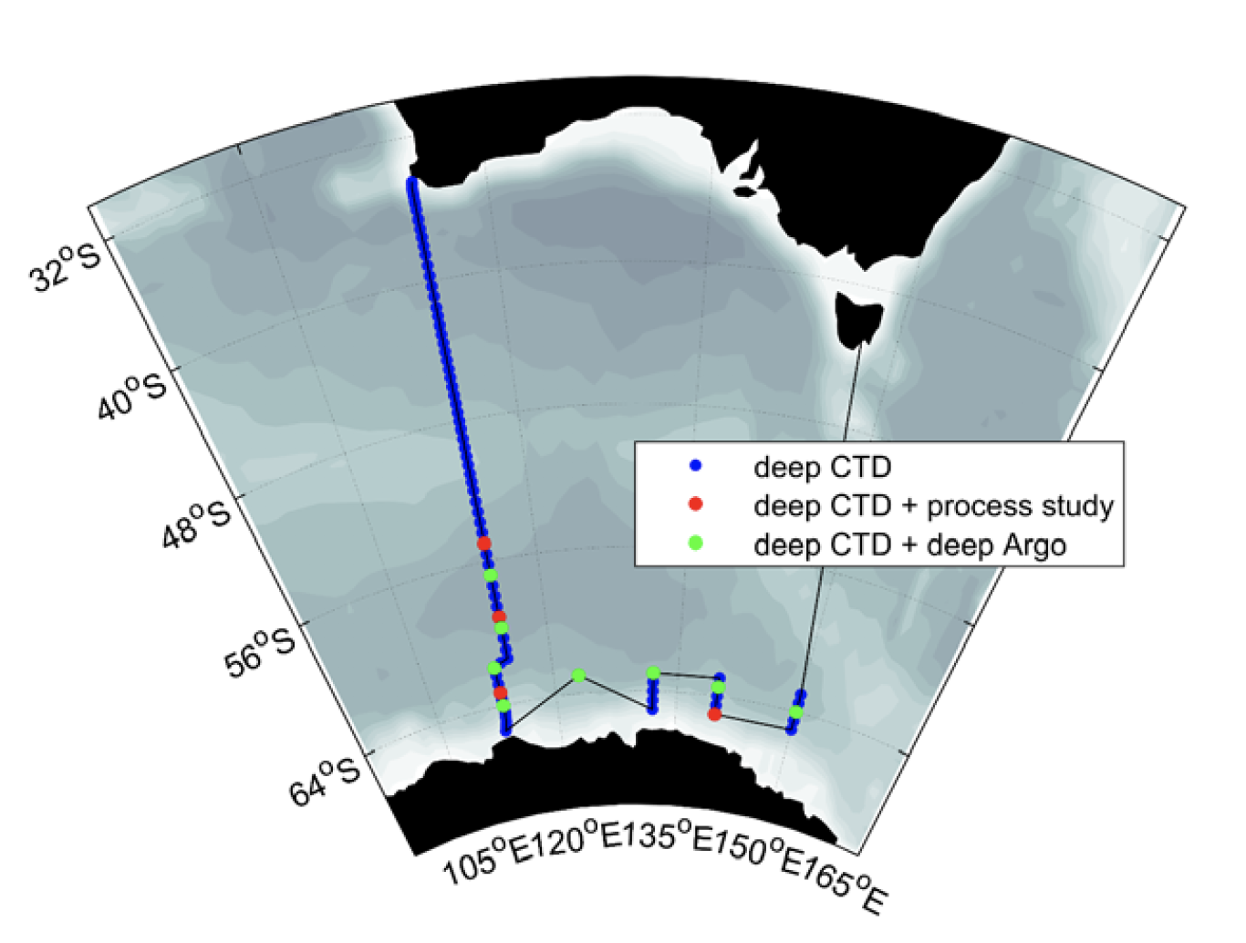
Where is that?
AUS & NZ
MISO (I9S)
location of CANYONS, Denman and SOTS
SOTS
Denman region
CANYONS

