Slide 1
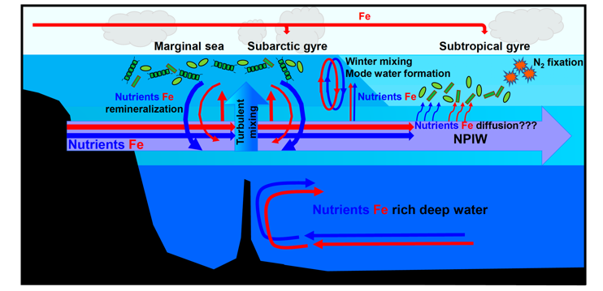
GEOTRACES Japan Activity
April 1st, 2020 – April 30th, 2021
GEOTRACES symposium and relevant sessions during scientific meetings (Online meeting)
- PICES 2020 annual meeting (Oct 2020)
- Geochemical Society of Japan (Nov 2020)
- Oceanographic Society of Japan (Nov 2020)
- Japanese GEOTRACES symposium (Mar 2021)
GEOTRACES relevant publications
Japanese GEOTRACES investigators published total 23 peer reviewed
journal articles.
Nishioka et al. (2020) Subpolar marginal seas fuel the North Pacific through the intermediate water at the termination of the global ocean circulation, PNAS, 117, 12665-12673.
Nishioka et al. (2020) reported the process that determine the chemical properties of intermediate water and uplift of Fe and nutrients to the main thermocline in the subarctic Pacific.

Slide 2
GEOTRACES GP22 Cruise in 2022
PI: Hajime Obata (AORI, U. Tokyo)
Ship: R/V Hakuho-maru
(JAMSTEC)
The ship is under renovation until the end of this year. It will get a 10,000-m of Vectran cable (Made in Japan). We will have a test cruise for clean sampling in February - March 2022.
Schedule (Tokyo - Tokyo)
Leg 1: June 30 – July 26
Leg 2: July 30 – Aug 24
Leg 3: Aug 30 – Sep 20
Sample type
Water
Sediment
Aerosol

Slide 3
