Slide 1
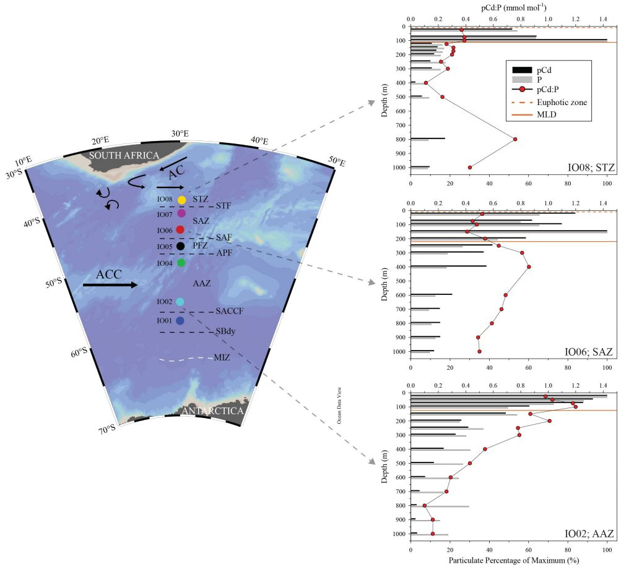
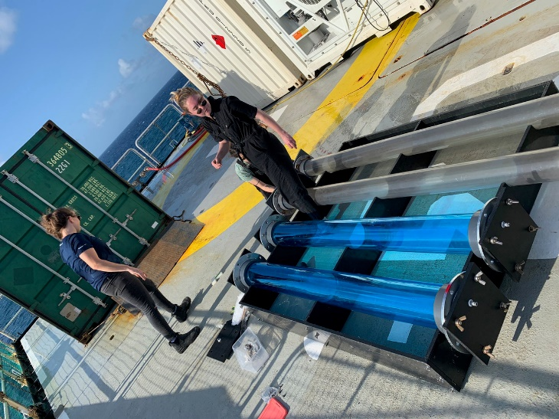
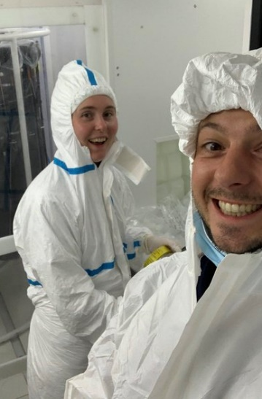
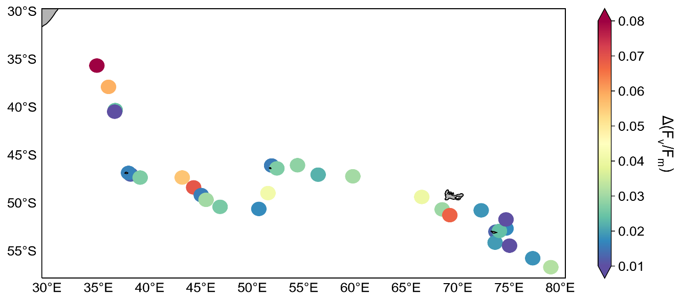
South Africa, Annual Report Highlights of completed work 2020-2021
Geotraces highlight Sept 2021, Dr Ryan Cloete
Cadmium in the Southern Ocean
Dr Tommy Keogh-Ryan, Heather Forrer
Participation in SWINGS cruise
Compiled by Susanne Fietz, Stellenbosch University, South Africa

Slide 2
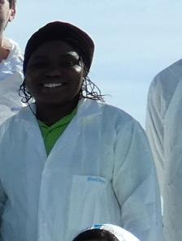
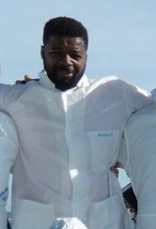
South Africa, Annual Report Planned activities
Focus on graduating good number of MSc and PhD candidates incl. from SADAC countries as potential future Geotraces reps.
No planned GEOTRACES special issue publications
National scientific cruise earliest in 2022 on board SA Agulhas II
No formal planning of target regions and dates (season) yet
Key concern: only couple of Southern Ocean and Antarctic projects were funded in the 2021-2023 cycle
Planned involvement in international partner cruises
SA activities relevant to Geotraces activities will likely include:
Major trace metals and iron speciation
Macronutrients and N-isotopes
Aerosols
Phytoplankton community and photophysiology
Microbiome
Compiled by Susanne Fietz, Stellenbosch University, South Africa
Example graduates 2021 (submitted Aug 2021) @Stellenbosch University:
Margret Ogundare, Nigeria
Ismael K. Kangueehi, Namibia

