Slide 1
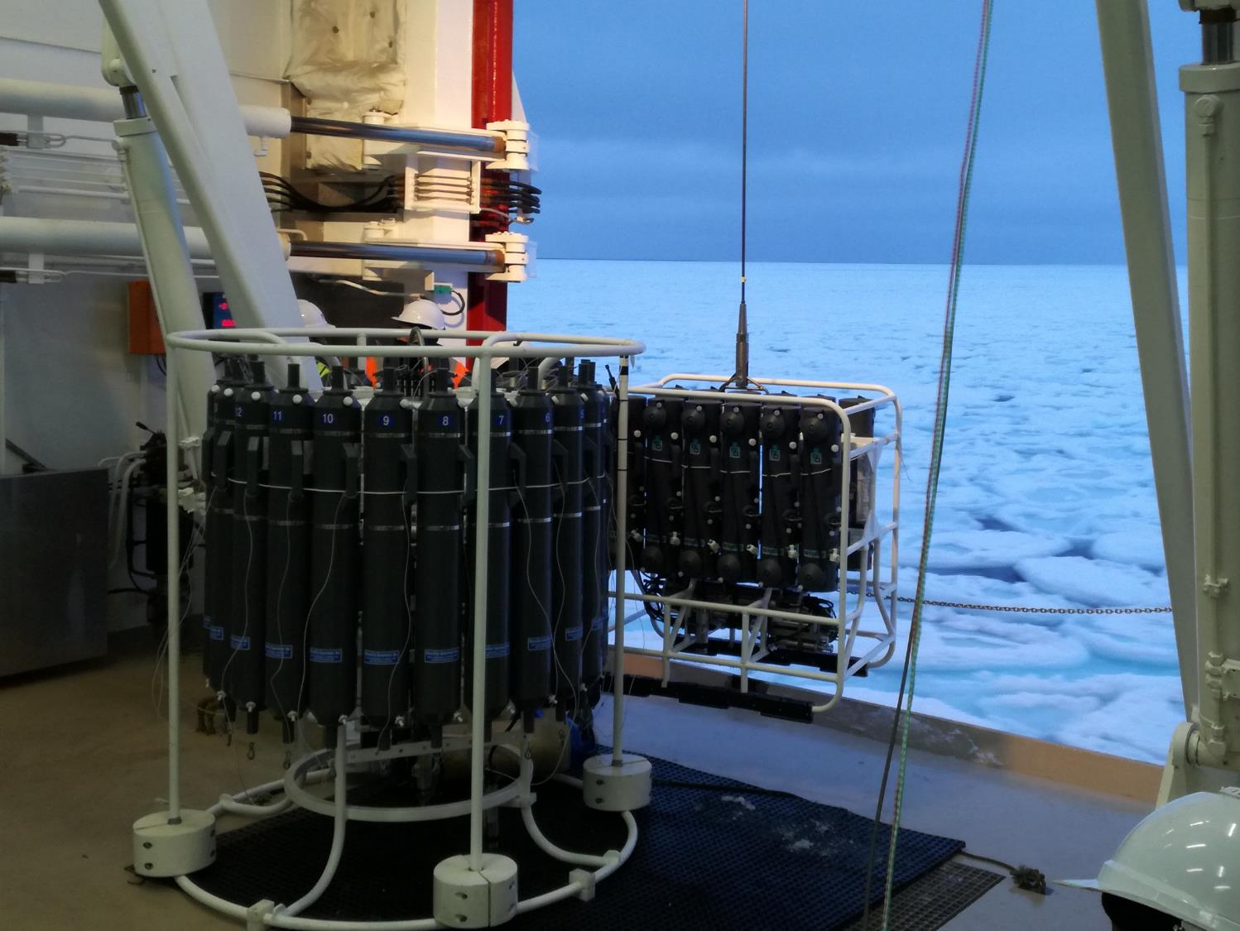
South Africa
Annual Report
2020-2021
Compiled by
Susanne Fietz, Stellenbosch University, South Africa, sfietz@sun.ac.za

Slide 2
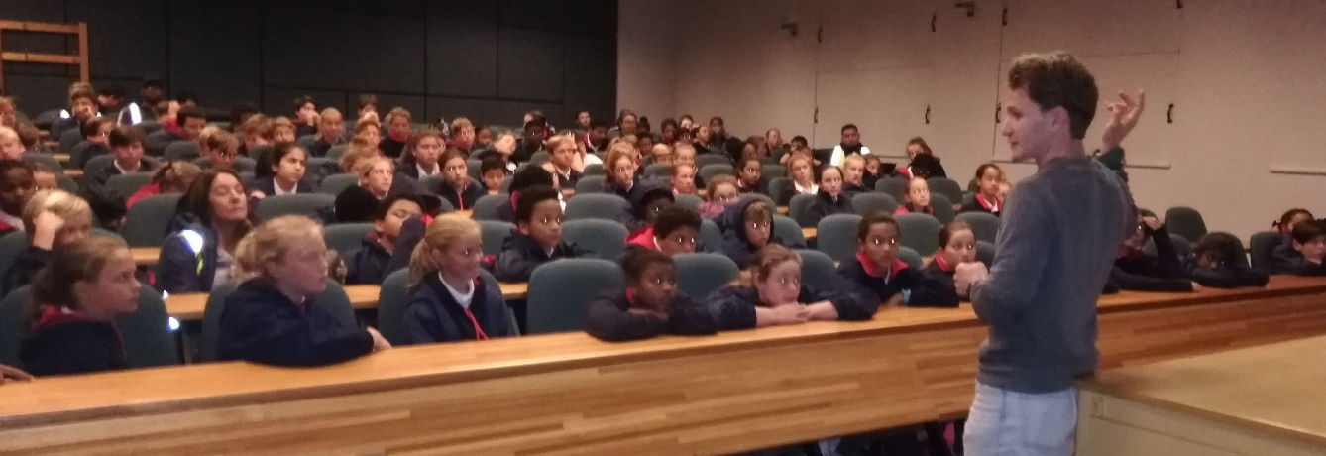
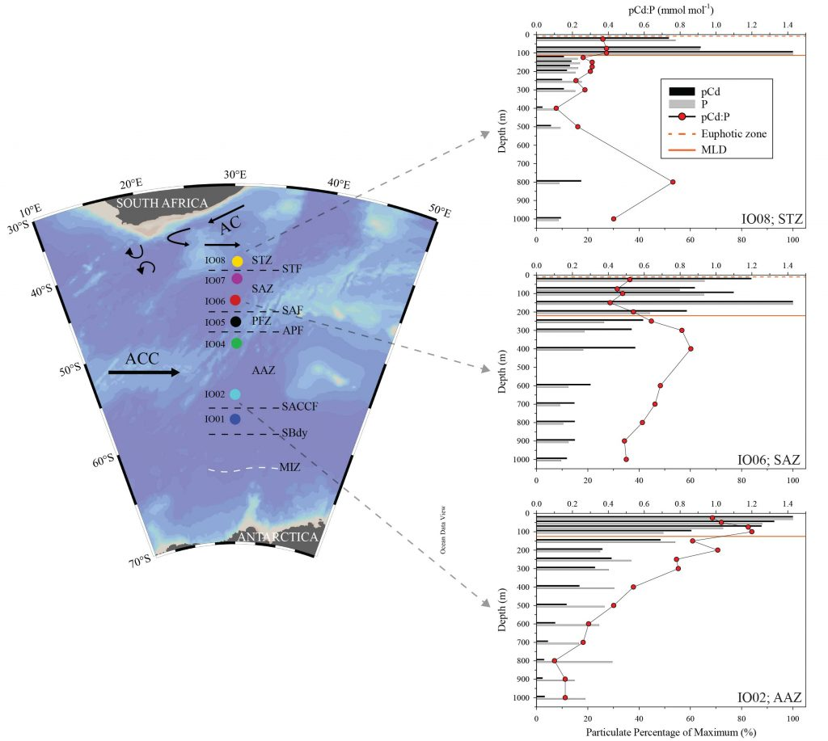
CADMIUM
Geotraces highlight
6 Sept 2021
Highlights
UNIQUE WINTER DATASET OF PARTICULATE AND DISSOLVED CADMIUM IN THE INDIAN SECTOR OF THE SOUTHERN OCEAN
Dr. Ryan Cloete
Front. Mar. Sci. 8:656321. doi: 10.3389/fmars.2021.656321

Slide 3
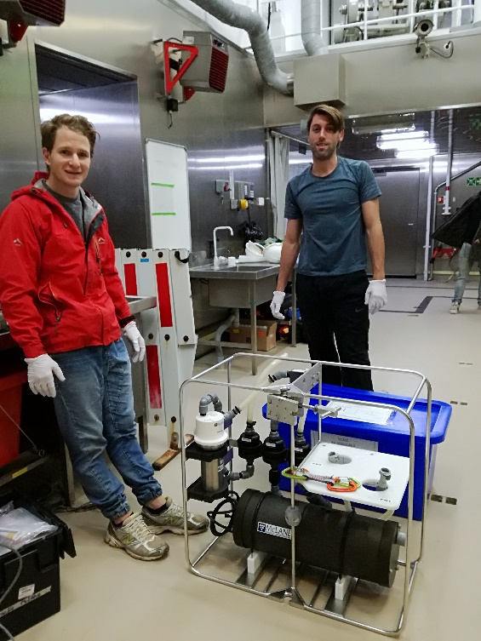
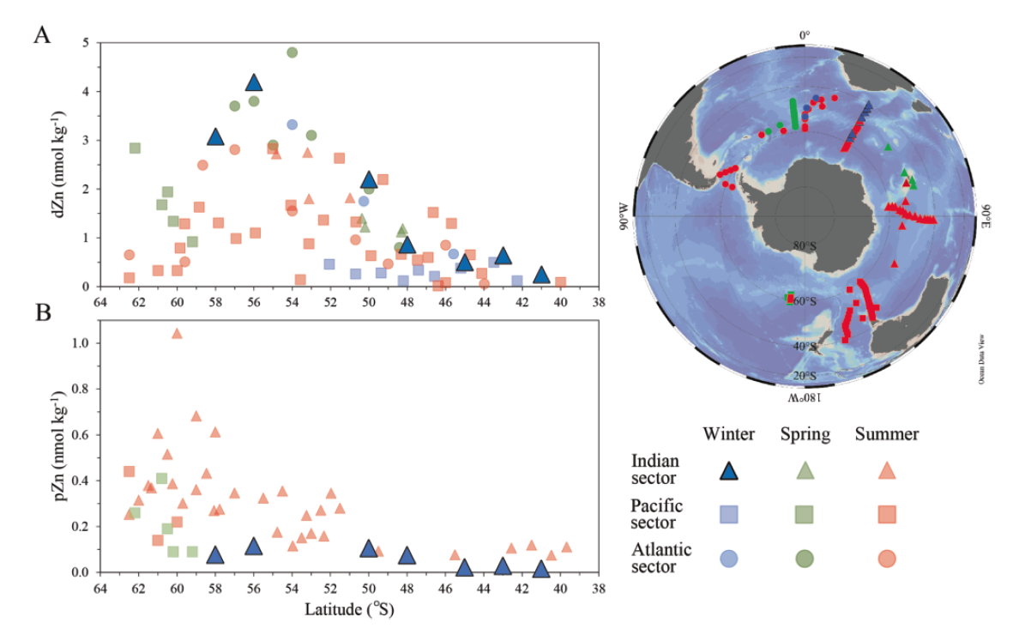
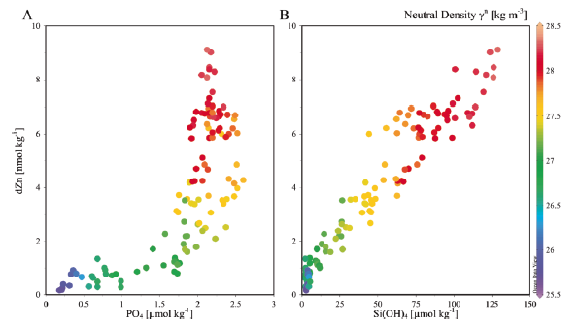
ZINC
Highlights
Dr. Ryan Cloete
Mar. Chem. 20 November 2021, 104031
https://doi.org/10.1016/j.marchem.2021.104031

Slide 4
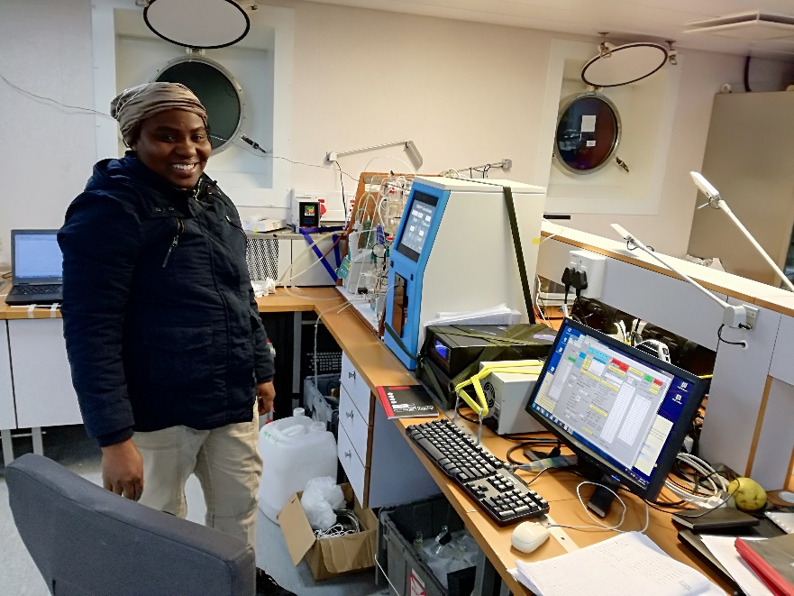
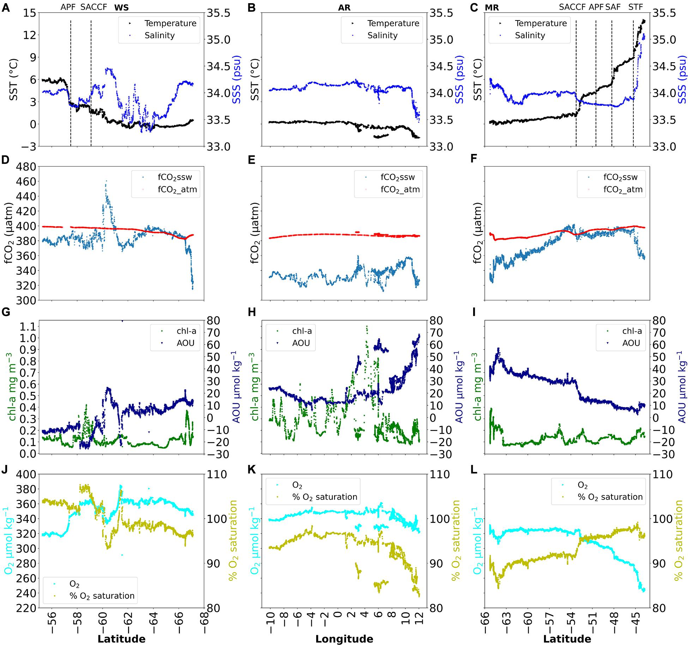
CO₂
Highlights
PhD cand. Margaret Ogundare
Front. Mar. Sci. 7:614263.
https://doi.org/10.3389/fmars.2020.614263

Slide 5
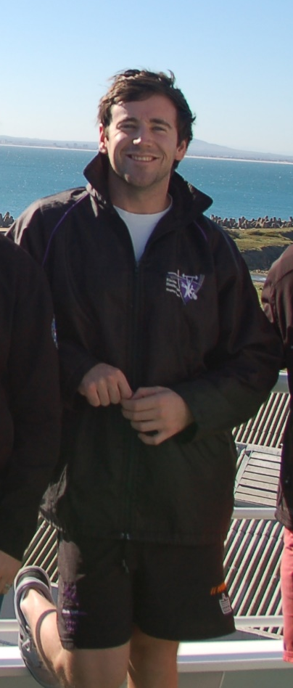
Diatoms and biogenic silica
MSc Ian Weir
(now at Anglo Platinum)
Highlights
DSR I, 166, 103421
https://doi.org/10.1016/j.dsr.2020.103421

Slide 6
SA-led Early-Career publications
2020-2021
2021
DATA SET: Viljoen, Johannes J; Fietz, Susanne (2021): Surface summer phytoplankton pigment concentrations measured by HPLC during the SANAE-56 cruise in the Atlantic Southern Ocean between December 2016 and February 2017. PANGAEA, https://doi.pangaea.de/10.1594/PANGAEA.932769
Cloete R., J.C. Loock, N.R. van Horsten, J-L. Menzel Barraqueta, S. Fietz, T.N. Mtshali, H. Planquette, M.I. García-Ibáñez, A.N. Roychoudhury. Winter dissolved and particulate zinc in the Indian Sector of the Southern Ocean: Distribution and relation to major nutrients (GEOTRACES GIpr07 transect). Marine Chemistry, 2021.​ https://doi.o​rg/10.1016/j.marchem.2021.104031​
Cloete R, Loock JC, van Horsten N, Fietz S, Mtshali TN, Planquette H, Roychoudhury AN. Winter biogeochemical cycling of dissolved and particulate cadmium in the Indian sector of the Southern Ocean (GEOTRACES GIpr07 transect). Front. Mar. Sci. 8:656321. https://doi.org/10.3389/fmars.2021.656321
Ogundare MO, Fransson A, Chierici M, Joubert WR and Roychoudhury AN (2021) Variability of Sea-Air Carbon Dioxide Flux in Autumn Across the Weddell Gyre and Offshore Dronning Maud Land in the Southern Ocean. Front. Mar. Sci. 7:614263. doi: 10.3389/fmars.2020.614263
2020
Ryan-Keogh T.J. and Thomalla, S. J., 2020. Deriving a proxy for iron limitation from chlorophyll fluorescence on buoyancy gliders. Frontiers in Marine Science, 7: 275, doi: 10.3389/fmars.2020.00275.
Ryan-Keogh T.J. and Smith Jr., W. O., 2020 Temporal patterns of iron limitation in the Ross Sea as determined from chlorophyll fluorescence. Journal of Marine Systems, 215, doi: 10.1016/j.jmarsys.2020.103500.
Weir I, Fawcett S, Smith S, Walker D, Bornmann T, Fietz S. Winter biogenic silica and diatom distributions in the Indian Sector of the Southern Ocean. Deep Sea Research Part I, 103421 (2020). https://doi.org/10.1016/j.dsr.2020.103421​
Smart S et al. 2020, The Nitrogen Isotopic Composition of Tissue and Shell-Bound Organic Matter of Planktic Foraminifera in Southern Ocean Surface Waters, Geochemistry, Geophysics, Geosystems. https://doi.org/10.1029/2019GC008440
Menzel Barraqueta JL. et al. , 2020, A First Global Oceanic Compilation of Observational Dissolved Aluminum Data With Regional Statistical Data Treatment. Front. Mar. Sci. https://doi.org/10.3389/fmars.2020.00468
Highlights ǀ Publications

Slide 7
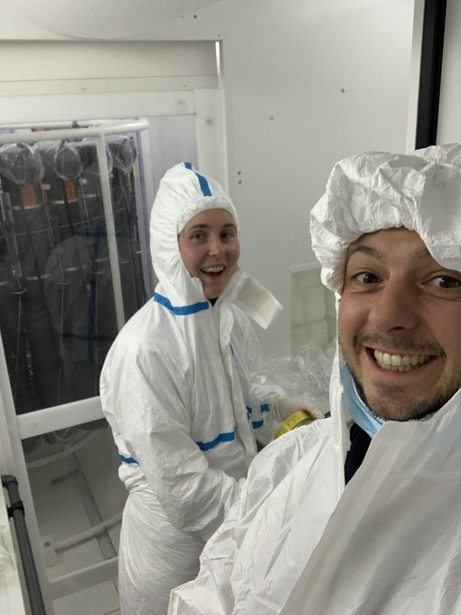
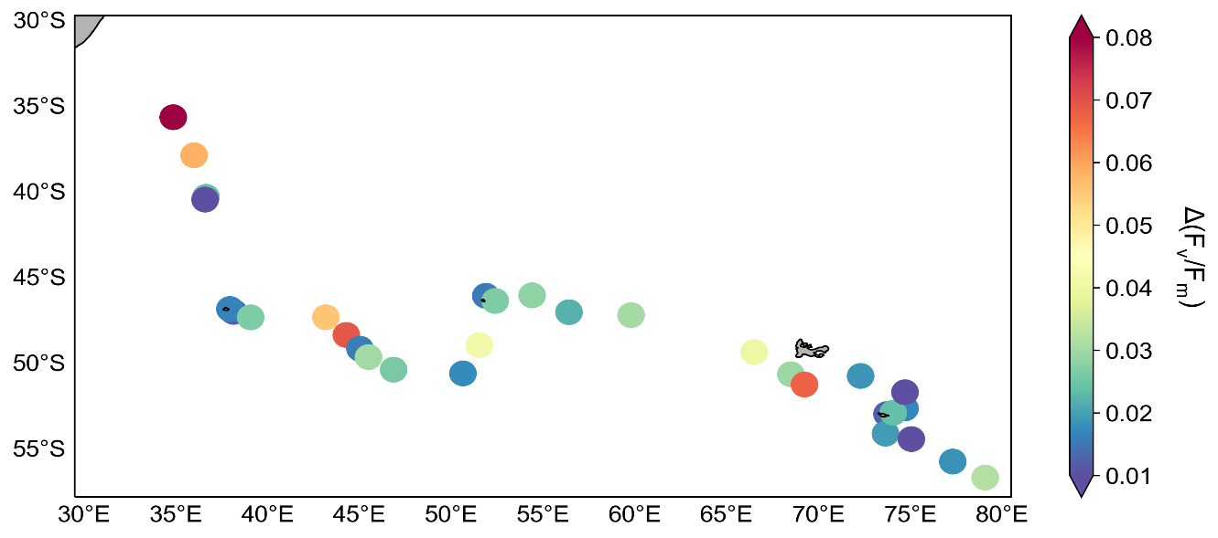
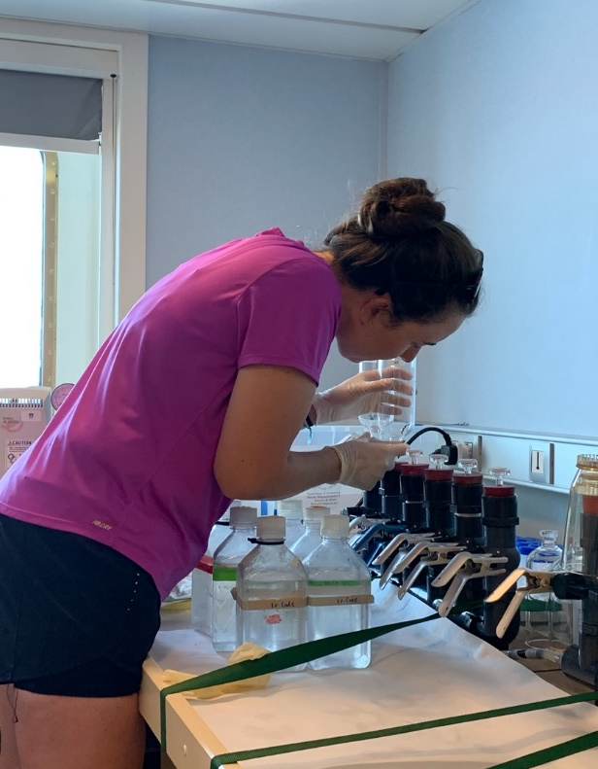
completed cruises: participation on SWINGS cruise 2020
Highlights ǀ Publications ǀ Completed Cruises
Dr T. Ryan-Keogh (CSIR) and Heather Forrer (UCT/FSU) participated on the French Geotraces SWINGS cruise, looking at the effects of iron addition on photophysiology, nitrogen uptake and primary production.

Slide 8
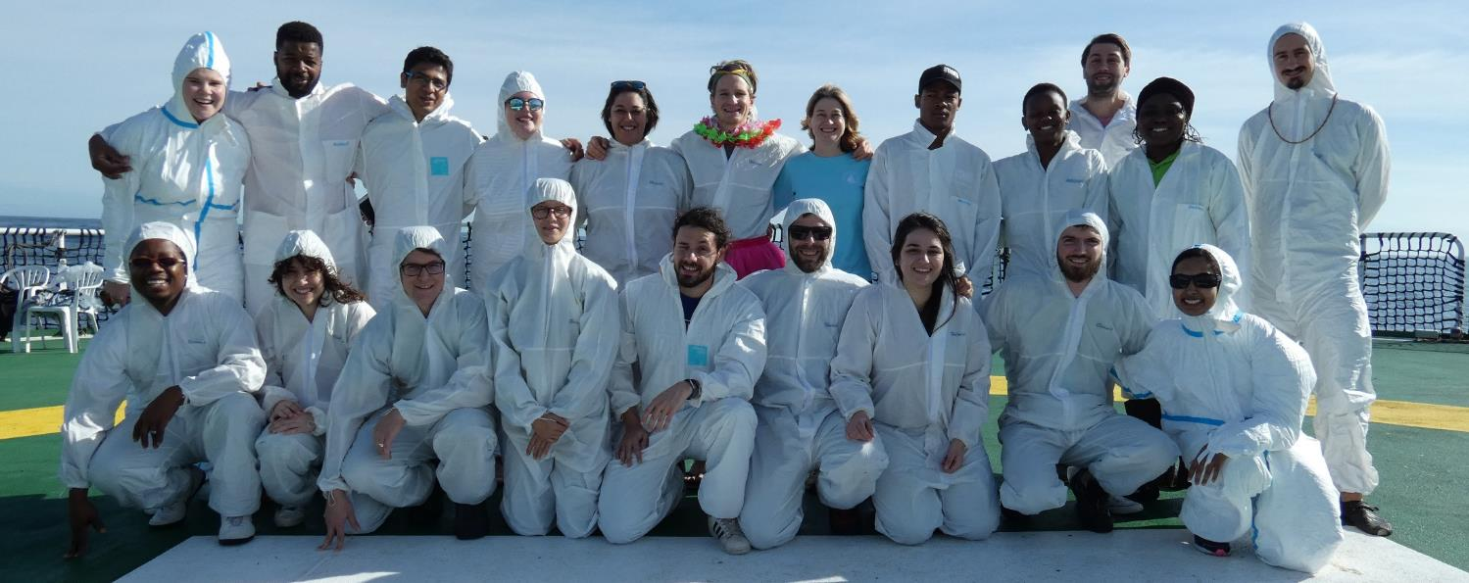
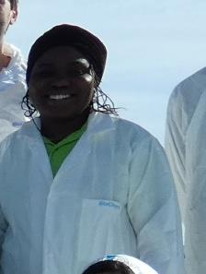
How do national activities help support the GEOTRACES mission
Young investigators Geotraces related
ECR Tommy Ryan-Keogh (CSIR)
Postdoc Saumik Samanta (SU)
Postdoc Jean Loock (SU)
Postdoc Ryan Cloete (SU)
PhD Margret Ogundare (SU) - submitted
PhD Ismael Kangueehi (SU) – submitted
PhD N. v. Horsten (CSIR, SU/Brest) – submitted
PhD Asmita Singh (CSIR/SU)
PhD Johan Viljoen (SU)
MSc Tara deJongh (SU)
MSc Andile Mkandla (SU)
MSc Emtia Wium (SU)
MSc Fortunate Shingange (UCT/CSIR)
Margret Ogundare, Nigeria
“exporting” the knowledge to other southern African countries

Slide 9
Future Plans
No planned GEOTRACES special issue publication
Scientific cruise earliest in 2022
on board SA Agulhas II
No formal planning of target regions and dates (season) yet
Only few Southern Ocean and Antarctic projects were funded in the 2021-2023 cycle
SA activities relevant to Geotraces activities will likely include:
    Major trace metals and iron speciation
    Macronutrients and N-isotopes
    Aerosols
    Phytoplankton community and photophysiology
    Microbiome
Highlights ǀ Publications ǀ Completed Cruises ǀ Future Plans

