Slide 1
Annual report on GEOTRACES activities in Germany
Prepared by Walter Geibert and Eric Achterberg

Slide 2
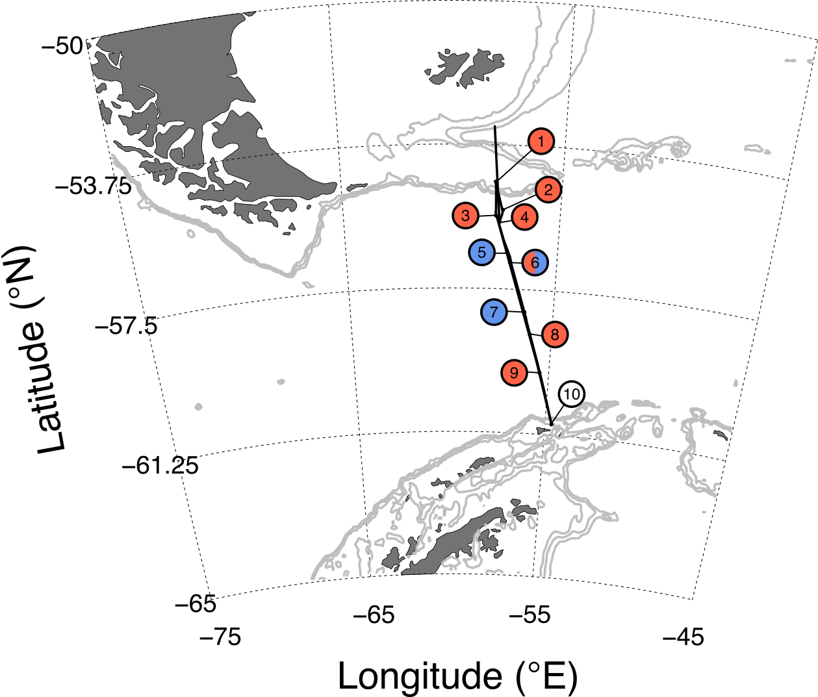
New scientific results
Ten experiments were conducted through Drake Passage in the Southern Ocean to test for phytoplankton growth limitation by iron and/or manganese. Sites with a red label were found to be iron limited, whilst those with a blue label were found to be manganese limited; split red-blue label indicates iron-manganese co-limitation, whilst the white label indicates no nutrient was limiting. Browning, T. J., Achterberg, E. P., Engel, A., & Mawji, E. (2021). Manganese co-limitation of phytoplankton growth and major nutrient drawdown in the Southern Ocean. Nature Communications, 12(1), 884. https://doi.org/10.1038/s41467-021-21122-6
Mixing relationships between Nd and Hf isotopes and salinity of the Congo River and open ocean surface waters. Rahlf, P., Laukert, G., Hathorne, E.C., Vieira, L.H., and Frank, M. (2021) Dissolved neodymium and hafnium isotopes and rare earth elements in the Congo River Plume: Tracing and quantifying continental inputs into the southeast Atlantic. Geochimica et Cosmochimica Acta 294, 192-214.

Slide 3
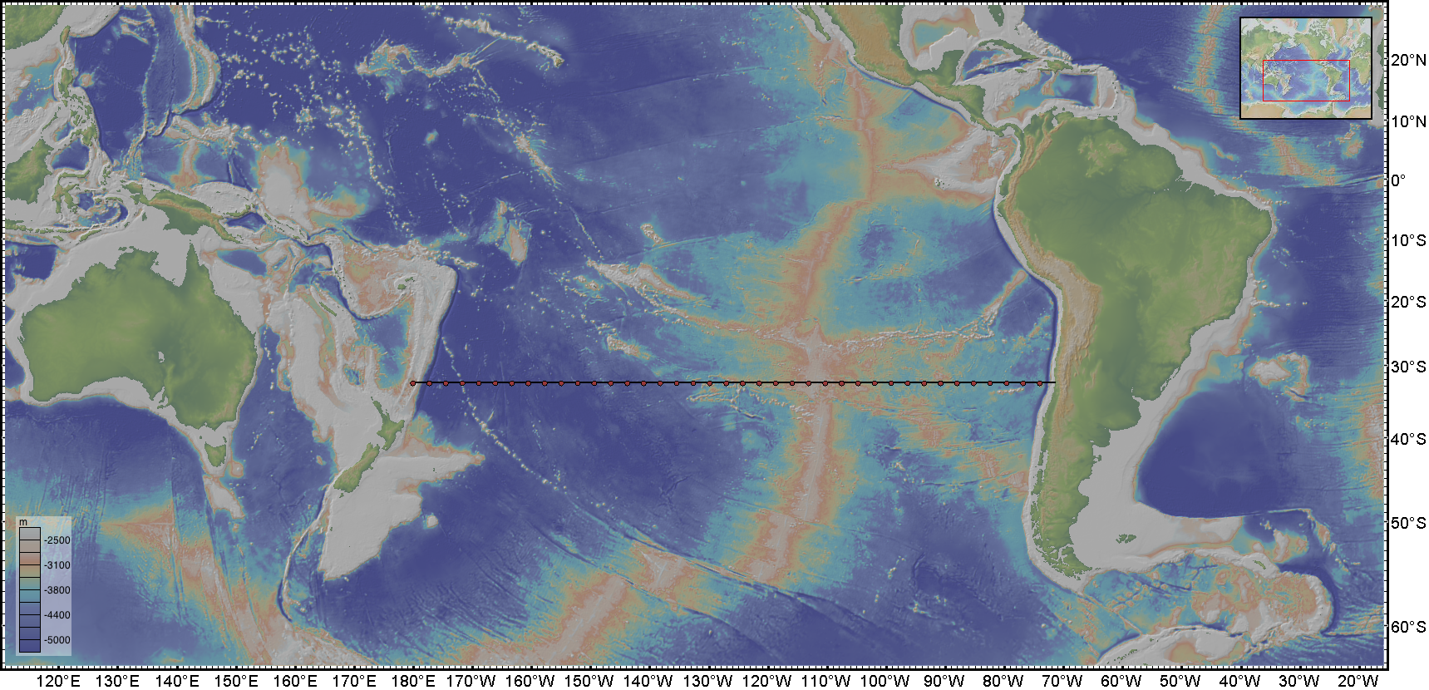
Upcoming cruises
GEOTRACES or GEOTRACES relevant cruises
Research cruise Amazon-GEOTRACES 2 to the Amazon estuarine region approved (supposed to take place in 2022, will be applied for as GEOTRACES process study) as a follow-up research cruise to M147 (Amazon-GEOTRACES, GApr11 in Apr.-May 2018)
Approval of Polarstern GEOTRACES cruise (section status planned) to the Central Arctic Ocean for 2024 (“ArcWatch-2”)
Award of cruise RainbowPlume as part of German Corona Cruise Proposal Round. Cruise is being sailed in period September 1 to October 6, 2021 (RV Meteor) and will investigate plume geochemistry at Rainbow vent field (mid Atlantic Ridge). PIs Achterberg, Koschinsky, Browning, Frank. We will apply for GEOTRACES Process Study status.
GP21 section cruise on FS Sonne in the South Pacific Ocean
has been re-scheduled for February 18-April 7 2022
(Achterberg, Frank, Koschinsky). Transect from Chile (Valparaiso) to New Caledonie (Noumea)

Slide 4
PhD thesis
Paffrath, R. (2020). Terrestrial Input of Rare Earth Elements and Neodymium Isotopes to the Ocean and their Transport and Cycling - Case Studies from the Arctic Ocean and the Southern North Sea. University of Oldenburg.
Rahlf, P. (2020) Tracing water masses and terrestrial inputs with radiogenic neodymium and hafnium isotopes and rare earth elements in the southeastern Atlantic Ocean. PhD thesis, University of Kiel, 131 p.,
New GEOTRACES or GEOTRACES-relevant publications (published or in press)
Over reporting period: 38 manuscripts published

