Slide 1
Netherlands report 2020-2021
Progress is being made with the interpretation and publication of the results results from cruises GA04N, ANA08B and PS117
Cruises & samples
  MetalGate cruise done July/August 2021 (outside reporting period)
  Sample analyses from cruise ANA08B and PS117, two GEOTRACES Process studies, is being finalised
Outputs
  8 publications in the reporting period with Dutch GEOTRACES scientists as (co-)authors
  2 phD theses completed

Slide 2
Netherlands report 2020-2021
Meetings and workshops
  2021 Netherlands earth science 5 presentations
  2020 SOOS Weddell Sea-Dronning Maud Land Working Group online workshop
(Upcoming) cruise
    Metal Gate process study around Iceland (postponed from 2020)
      Successful despite some Covid related hick ups
National activities and GEOTRACES Mission
  The national activities contribute to:
    The understanding of distributions of key trace elements and isotopes in the ocean via the organization and execution of GEOTRACES process studies
    The next IDP by submission of data and S&I reports
    Outreach via public lectures and awareness by underlining the collaborative GEOTRACES efforts in national initiatives

Slide 3
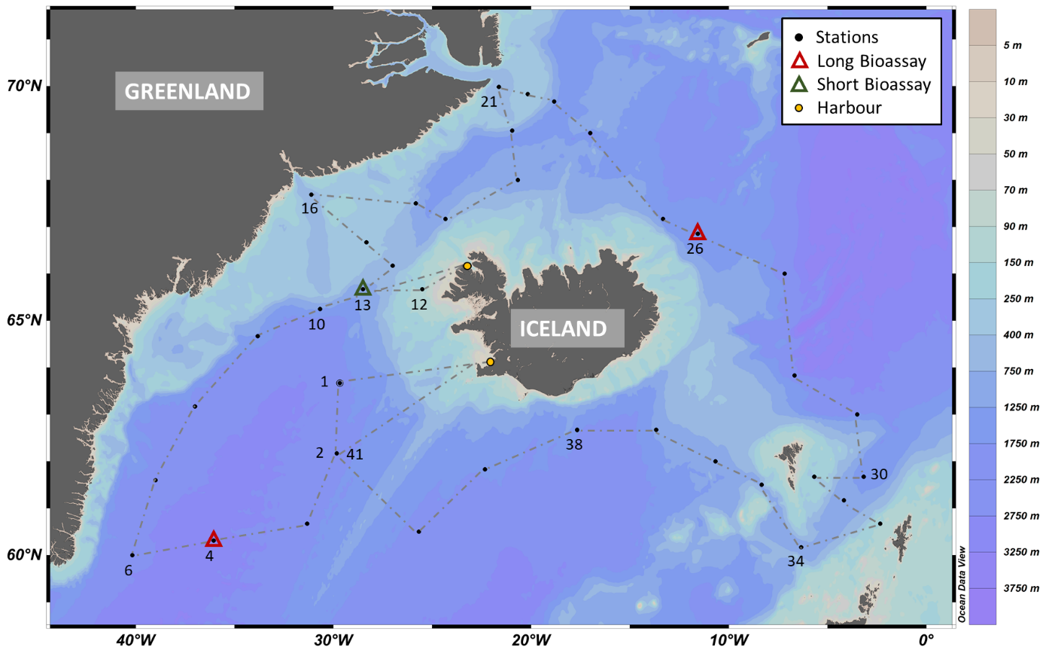
Netherlands report 2020-2021

