Slide 1
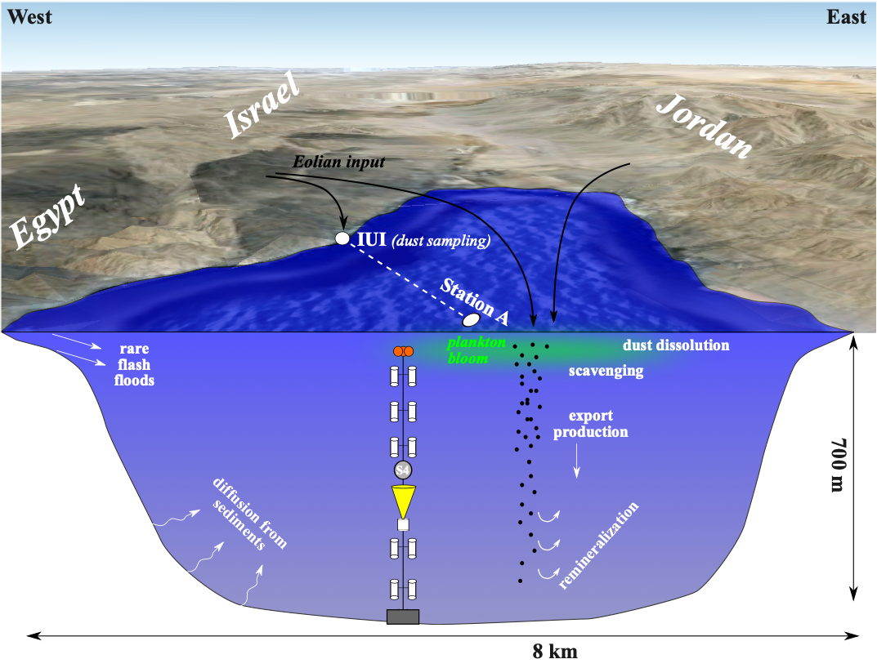
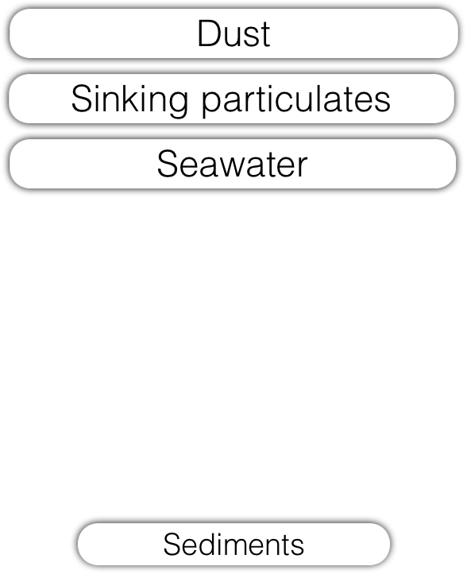
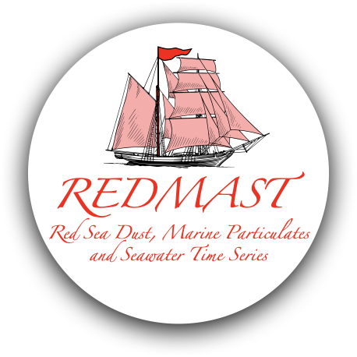
Israel
GEOTRACES SSC report
(2020-2021)
Red Sea process study
New results from the past year:
The interplay between seawater aluminum, silica and dust
Atmospheric dust sequential leaching: TEs and U and Nd isotopic compositions
Planktonic foraminifera trace element time series
Cruise in eastern Mediterranean
Link to webpage:
https://sites.google.com/mail.huji.ac.il/torfstein-lab/redmast

Slide 2
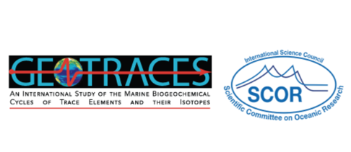
Data Synthesis
Shaked, Y., Twining, B. S., Tagliabue, A., & Maldonado, M. T. (2021). Probing the bioavailability of dissolved iron to marine eukaryotic phytoplankton using in situ single cell iron quotas. Global Biogeochemical Cycles, e2021GB006979.
Shaked, Y., Buck, K. N., Mellett, T., & Maldonado, M. T. (2020). Insights into the bioavailability of oceanic dissolved Fe from phytoplankton uptake kinetics. The ISME Journal, 1–12.
Next
Analyzing uptake data of natural ocean water with the Fe(II)_{s} model (Shaked et al. 2005).
Goal - Assessing the effects of speciation (ligands), photochemistry and temperature on dFe bioavailability
Needed – in situ uptake rates / cultures uptake & growth with natural SW
Assessing bioavailability of aerosol Fe to phytoplankton – adding physical (interactions) and biological components

Slide 3
New Germany-Israel collaborative project in the eastern Mediterranean (PI’s Eric Achterberg & Ilana Berman-Frank):
The aim of the Helmholtz International Laboratory ‘Eastern Mediterranean Sea as a model for Future Ocean Research (EMS FORE)’ is to use the EMS, from coastal to deep ocean, as a natural laboratory to gain mechanistic and quantitative understanding of biogeochemical and ecosystem transitions of a future (sub)tropical ocean affected by global warming and other anthropogenic pressures.

