Slide 1
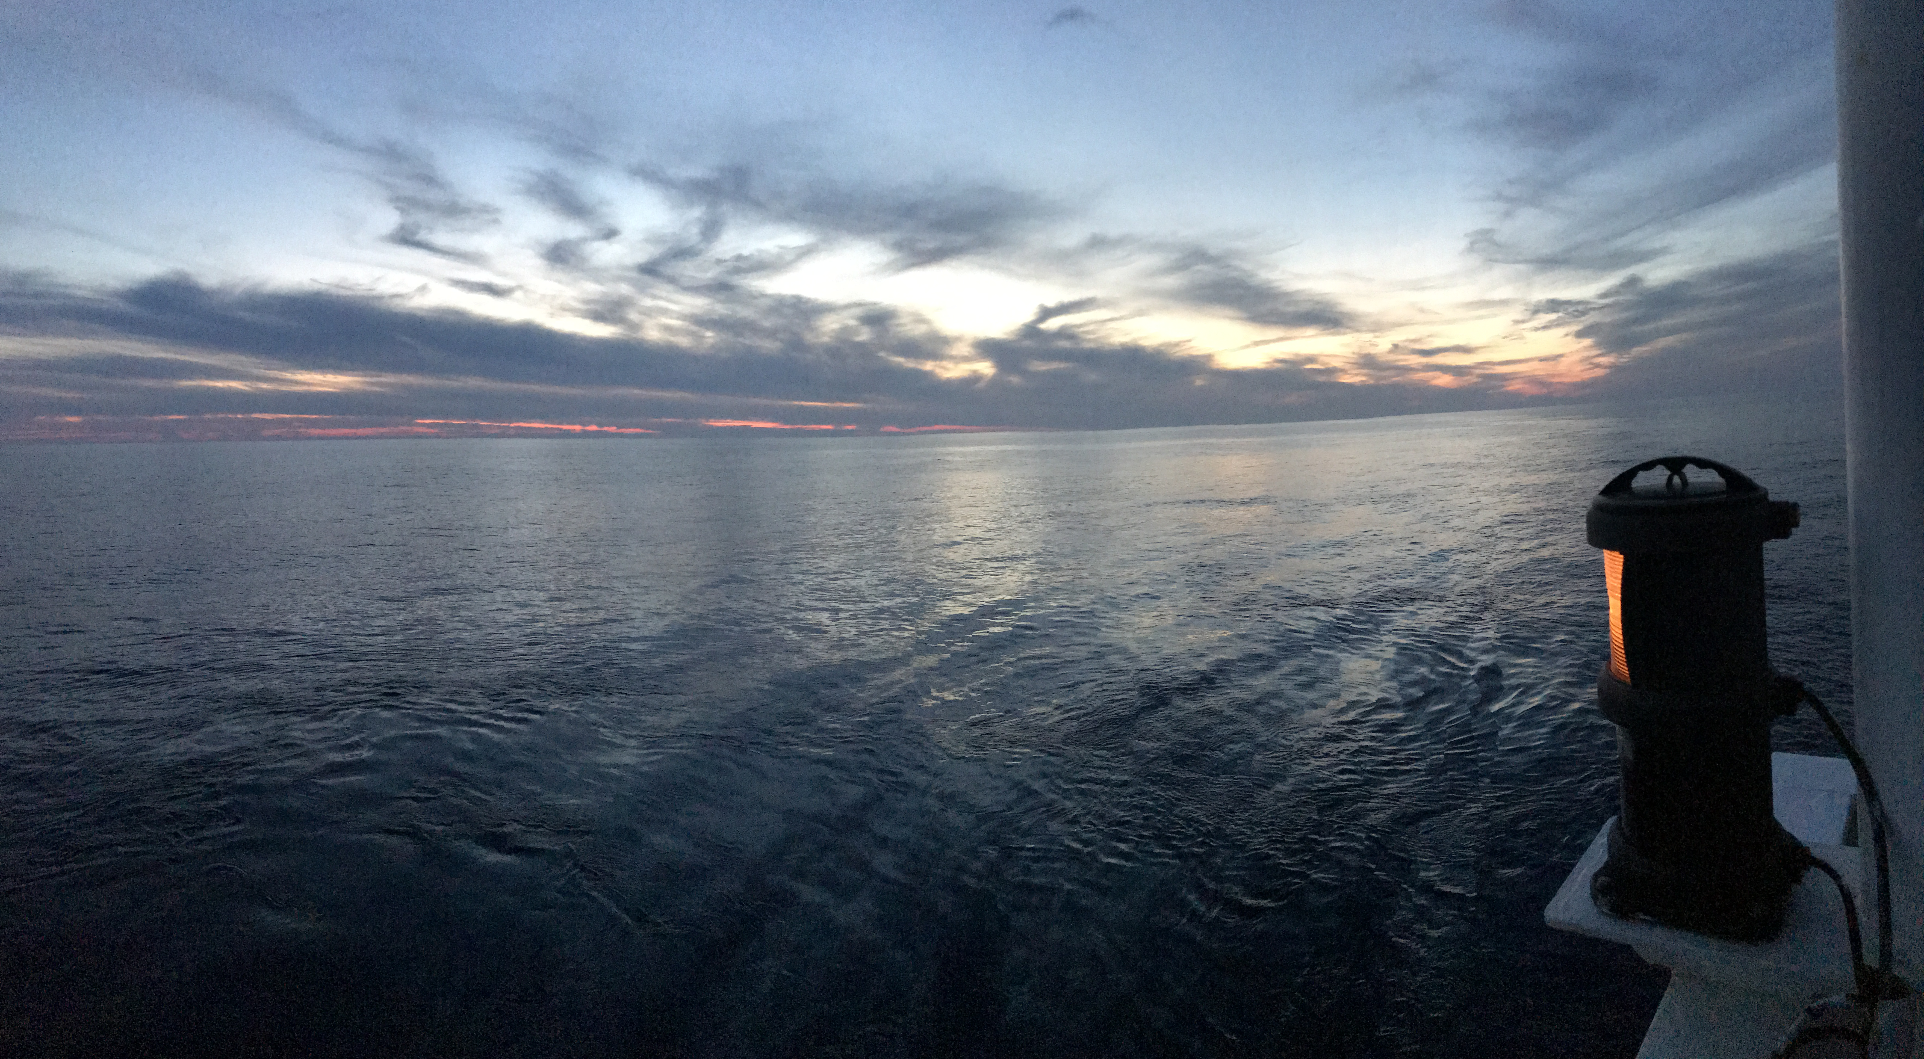
Geotraces – Spain
2021 Geotraces SSC meeting
Virtual meeting
September 29 – October 1, 2021

Slide 2
Geotraces - Spain
Participants (Contributions 2020 - 2021)
Francisca Martínez-Ruiz (CSIC): Geochemistry
Pere Masqué (UB, Barcelona): Radioactive isotopes
Carles Pelejero (CSIC, Barcelona): Radioactive isotopes
Ricardo Prego (CSIC, Vigo): Trace metals
María Villa-Alfageme (US, Sevilla): Trace metals and REE
Juana M. Santana Casiano (ULPGC, Las Palmas): Trace metals
Melchor González-Dávila (ULPGC, Las Palmas): Trace metals
Aridane González (ULPGC, Las Palmas): Trace metals
A. Tovar-Sanchez (CSIC, Cádiz): Trace metals
Antonio Bode, Marta Álvarez, Marta Varela, Elisa Fernández, Manuel Ruiz, Mar Nieto-Cid, Mercedes de la Paz, Tamara Rodríguez Luz García, Pilar Díaz, Gelines Louro, Martinho MA (IEO, Coruña): Biochemistry

Slide 3
Activities
Cruises: 1
Peer review articles : 22
Meeting (poster and oral communications): 5
PhD Thesis: 1
Teaching: 2

Slide 4
Future Activity
Research Networks 2021
Geotraces España: Geotrac-ES
Coordinate the main groups with interests on Geotraces
Propose a coordinate oceanographic campaign
Acquire Clean CTD-rosette

Slide 5
Thanks

