Slide 1
Planning cruise 1: The western North Pacific
Region: 35 N, 148.5 E – 161.5 E; 155 E, 28.5 N – 40.5 N
Time (to be confirmed): May – June, 2022
Main objectives: to understand key processes and mechanisms of the biological pump in regions in and around the western boundary current (i.e., the Kuroshio Current and Extension) of the North Pacific
material transport and exchange driven by the Kuroshio Current and Extension
the coupling and/or decoupling of carbon fixation, nitrogen fixation, and iron limitation
Likely a couple of berths available for the international community

Slide 2
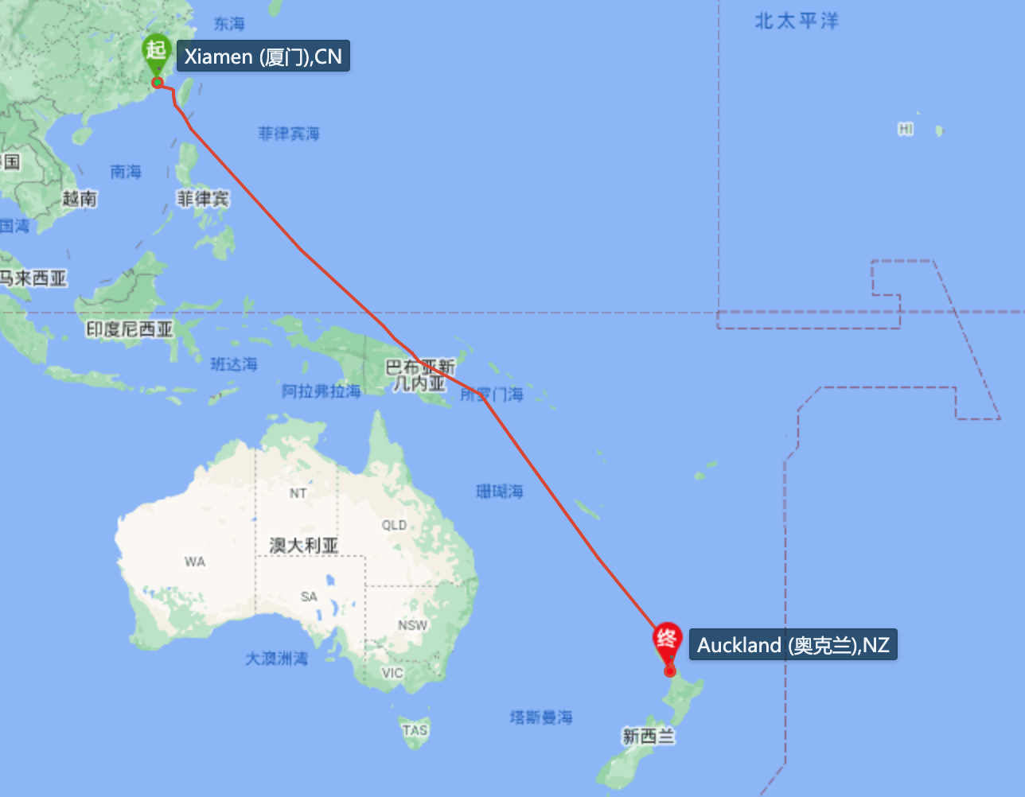
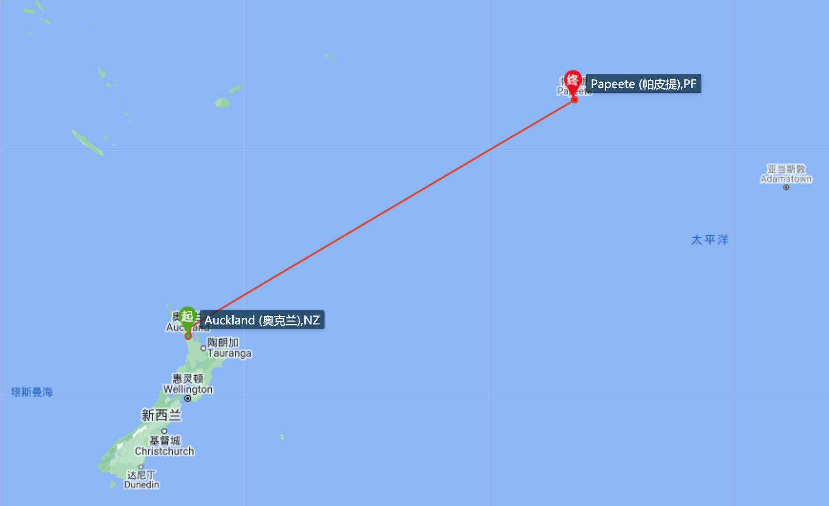
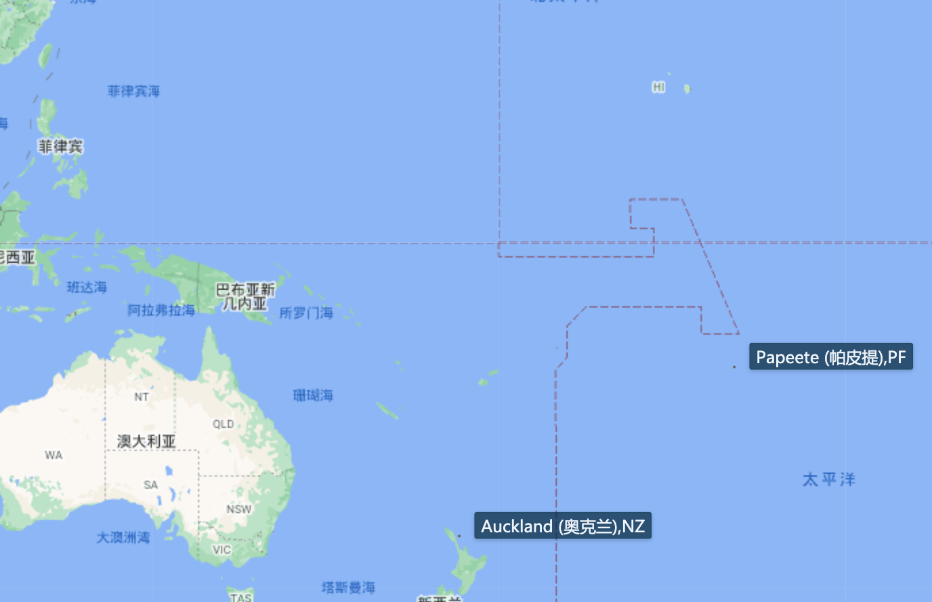
Planning cruise 2: The Southern Pacific
Three Legs:
Leg I: Xiamen, China – Auckland, New Zealand (~35 days)
Leg II: Auckland, New Zealand – Papeete, Tahiti (~24 days)
Leg III: Papeete, Tahiti – Xiamen, China (~33 days)
Time (tentative): Nov 2022 – Mar 2023
Main objectives: under discussion
Several berths availble for the international community

