Slide 1
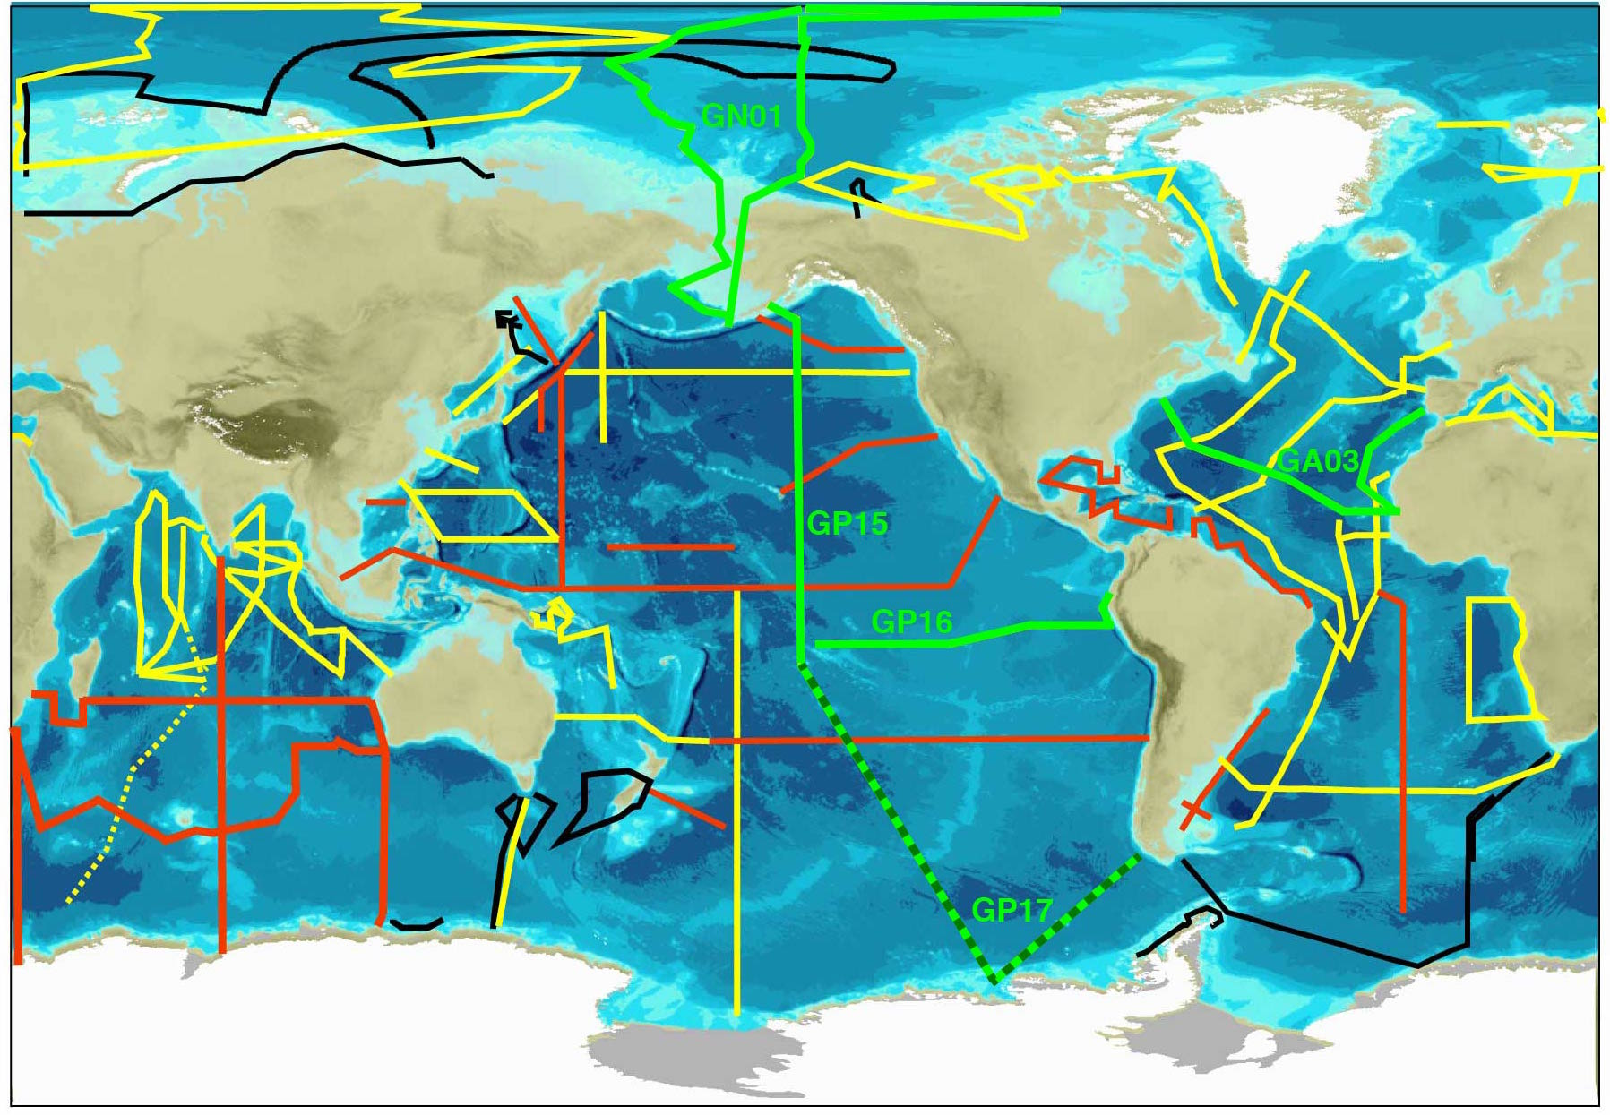
US Sections in Green
Notes:
Arctic special issue in JGR Oceans

Slide 2
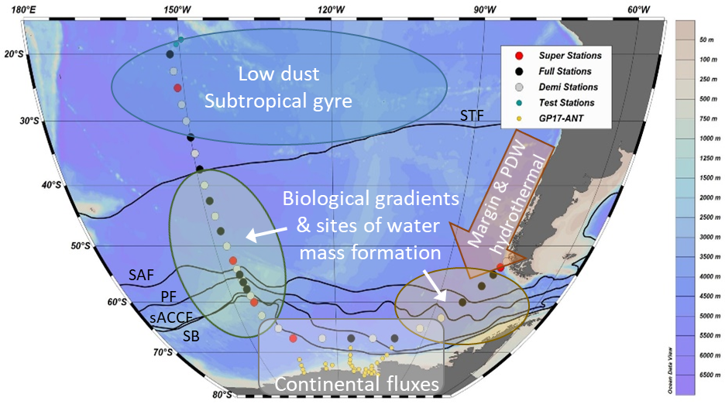
GP17 Two-ship Plan

