Slide 1
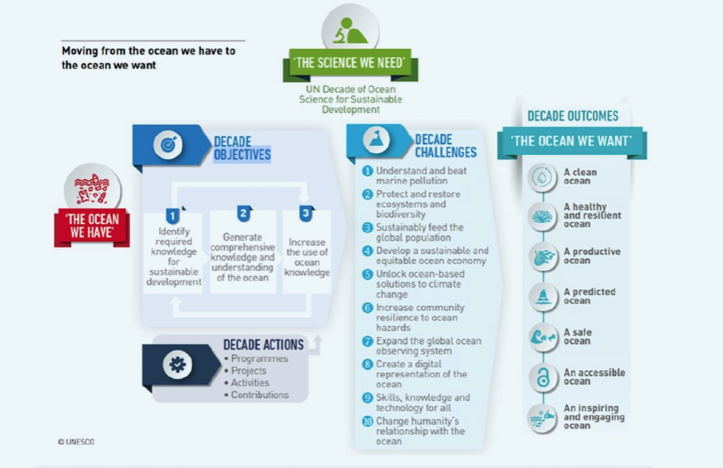
Ocean Decade (2020-2030) - Launched in January 2021 – convening framework for a wide range of stakeholders across the word.
Vision: “The science we need for the Ocean we want”
Mission: to catalyse transformative ocean science solutions for sustainable development, connecting people and our ocean”
Implementation Plan (January 2021) organised around:
- 7 Outcomes (describing the ocean we want)
- 10 Ocean Decade Challenges represents the most urgent needs (they will evolve)
- 3 Objectives to deliver actions (they will be updated)

Slide 2
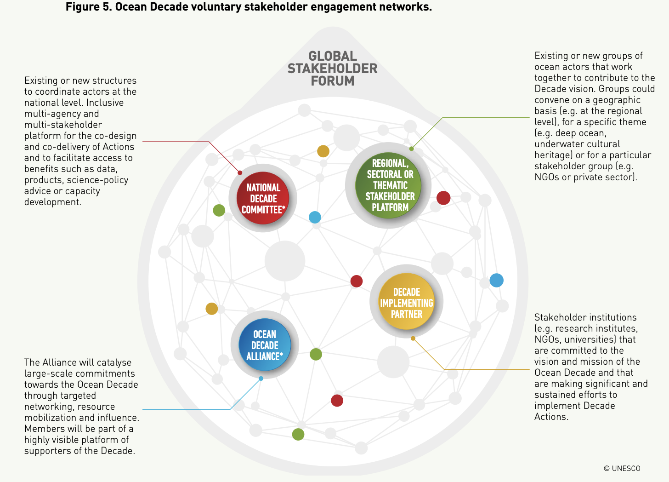
How to engage:
Ocean Decade Actions -> Tangible initiatives that will be implemented across the globe over the next ten years. -> Bottom-up -> requests via periodic calls for action.
Stakeholders engagement -> Stakeholders networks (voluntary and self-organized) -> Global Stakeholders Forum ->Both virtual and physical on-line plaform to be launched in October – “Linkedin of Ocean Decade”.
->hybrid international/regional conference series.
Generation Ocean (GenO) campaign/Brand -> to involve the stakeholders (public) (calls for action such photo competitions, etc.) -> feature testimonials of citizens “Ocean Decade Champions”
Ocean Decade Alliance ->Resource mobilization mechanism (platform to connect providers with proponents)
Participate in the 1st International Ocean Decade Conference June 2021 – July 2022: Series of Ocean Decade Laboratories (one for each challenge) + satellite events. -> Organised by the Federal Ministry of Education and Research (Germany).

Slide 3
-> Only collective effort can succeed to protect the ocean -> GEOTRACES
Early Career* Ocean Professional (ECOP) Programme
Global network of ECOP to foster collaborations, provide opportunities to elevate their voice and identfy, create and share professional development opportunities.
*Early career: Received the highest degree within the past 10 years.
1 ECOP representative per action (may be more in the future).
GEOTRACES - Ocean Decade Action (contribution)
NSF coordinated proposal submitted in January 2021
GEOTRACES selected in the first call in June 2021 (more than 60 selected)
Primary contact: Hedy Edmonds/Stacy Aguilera (now Clea Herrelson)
Communication Focal Point: Elena Masferrer, GEOTRACES IPO
ECOP Focal Point: Laura Whitemore (provisional appointment)

Slide 4
What this means:
Communication:
Can use the logo and all the communication resources (toolkit in dev) -> factsheet about GEOTRACES in progress.
Upload events on the Ocean Decade website + organise them
Participate in one or more Community of Practice (Stakeholders forum) and/or coordinate them.
GEOTRACES needs to provide a brief annual report.
No funding is associated (contributions) → Gain of visibility for GEOTRACES research/data
List of activities during the 2 first years:
(1) Provide a new release of the IDP (2) Organize promotional events to intensify the use of IDP
(3) Advance the implementation of the field work programme
(4) Maintenance of the international on-line database and Atlas
(5) Intensify the synthesis of GEOTRACES scientific results
(6) Continue to train young researchers worldwide,
(7) Developing capacity for GEOTRACES science worldwide
So far:
- Participation in the communication webinar – 15 Sept 21
- Paticipation in the first Ocean Decade Action webinar in 28 Sept. (yesteday!)
- NSF Ocean Decade Actions coordination meting – in October (tbd)

Slide 5
Current opportunities for GEOTRACES:
(1) Organising a satellite event at the 1st Ocean Decade International Conference (June 21 – July 22): Ocean Decade Laboratories https://www.oceandecade-conference.com/en/ocean-decade-laboratories.html
- 22 to 24 February 2022: Laboratory "A Productive Ocean" (submission deadline: 16 November 2021)
- 9 to 11 March 2022: Laboratory "A Healthy and Resilient Ocean" (submission deadline: 11 January 2022)
- 5 to 7 April 2022: Laboratory "A Safe Ocean" (submission deadline: 25 January 2022)
- 10 to 12 May 2022: Laboratory "A Transparent and Accessible Ocean" (submission deadline: 15 March 2022)
IDP2021 event?
e.g. Decade Action design workshops, virtual exhibitions, launch of videos or art initiatives, etc.
GEOTRACES has already participated in the second Laboratory on “Ocean Prediction” - > Webinar for the general public organised by NSF –> Phoebe Lam presented GEOTRACES

Slide 6
